Slide 1
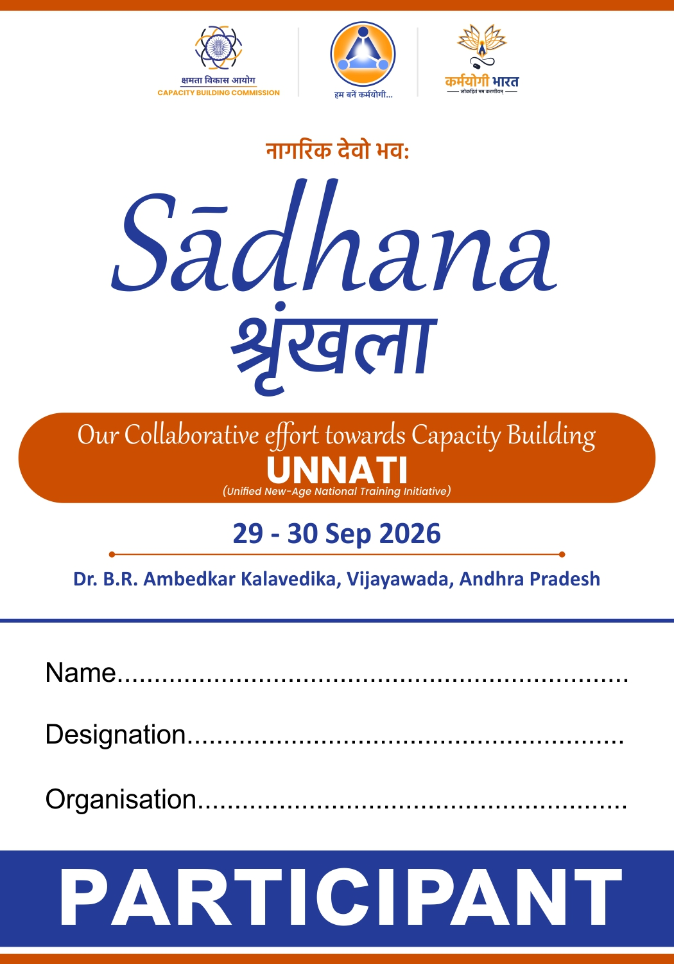


REFLECTION
on Day 1
Planning Department, Government of Andhra Pradesh

Slide 2
Inaugural Session: Setting the Context
Continuous learning must ultimately translate into better public service.
The Second Grade Teacher's learning journey gave that ambition a human face.
Seva Bhav
Reflection
Practice
Reinforcement
Citizen Outcome
Reconnect purpose with public
service​
Learn from lived experience​
Create Karmayogi moments​
iGOT + Samuhik Charcha​
Responsive service delivery​
“Bring universities and the private sector into the capacity-building ecosystem to strengthen continuous learning and innovation.”
- HCM, Andhra Pradesh

Slide 3
Session 1
Transformation from TIs to Capacity Building Institution through UNNATI

Slide 4

From Training to Capacity Building
Traditional
Mission Karmayogi
1
Rule-based
Designation-driven
Role-based​
Role-driven​
2
Prescribed training
Periodic TNA
Competency-based
learning​
Continuous CBPs​
3
One-size-fits-all
Course-centric
Role-specific interventions​
Outcome-centric​
How The Ecosystem Works
Government priorities
Capacity Building Plans
Competency framework
Application levels
Learning interventions
Define roles & functions
Identify required competencies
Functional • Behavioural • Domain
Strategic • Tactical • Operational
Aligned to role & outcomes
Right Competencies • Right Role • Right Time

Slide 5
How TIs Become Capacity Building Institutions
UNNATI connects demand intelligence with intervention design and institutional delivery.
Government Priorities
Roles & Functions
AI Driven CBPs on iGOT
UNNATI
Demand Intelligence
Learning Intervention Design
UNNATI Exchange
Institution Delivery
Three Institutional Capabilities
Understand Demand
Translate Demand
Deliver Effectively
Identify competency requirements
Analyse role-based capacity needs
Use CBPs as the source of demand
Convert demand into learning solutions
Prioritise target cohorts
Design suitable interventions
Access courses, faculty & infrastructure
Collaborate across institutions
Improve quality & scale via UNNATI Exchange
From delivering programmes to managing the complete capacity-building lifecycle | Better competencies → Better governance → Better citizen outcomes

Slide 6
Session 2
Karmayogi Quality Framework (KQF) for TIs

Slide 7
Karmayogi Quality Framework (KQF)
KQF shifts quality assurance upstream, building quality into learning from curriculum architecture through continuous improvement.
01
Discover
02
Design
03
Develop
04
Deliver
05
Evaluate
06
Improve
›
›
›
›
›
Capability need
Learning architecture
Learning assets
Learning experience
Quality & outcomes
Continuous refinement
Quality Principles
Quality by design
Anchored in work context
Architecture differentiation
1
2
3
Quality is engineered into the lifecycle, not inspected only at the end.
Learning connects competency requirements with the realities of an official’s role.
Curriculum design and course assurance work as distinct, complementary layers.
KQF Implementation Architecture
NCDF
Curriculum architecture + competency-based learning design
Quality Evaluator
AI-enabled review + validation + improvement
One framework • Two complementary engines • Continuous quality improvement

Slide 8
From Architecture to Quality Assurance
NCDF defines what good learning should look like; the Quality Evaluator checks whether individual courses meet that intent.
National Curriculum Design Framework (NCDF)
Quality Evaluator (QE)
Designs for capability
Assures Course Quality
A structured curriculum lens that starts with the role, competency and work context.
AI-supported review creates a consistent quality gate, with human review where needed.
WHAT
capability must be built?
COURSE
Submission
WHO
is the target learner?
›
AI
Quality Review
LEVEL
›
Strategic • Tactical • Operational
RAG
Scoring (Red, Amber & Green)
CONTEXT
›
where will the capability be applied?
ADMIN
Review
HOW
›
should learning be experienced?
SME
If required
Competency-based • Role-based • Learner-centred • Work-contextual
›
Design orientation
DECIDE
Publish • Improve • Rework
KQF = Structured curriculum design + AI-supported quality assurance → Consistent • Contextual • Outcome-oriented capacity building

Slide 9
Session 3
Karmayogi Kartavya Karyakram (KKK)

Slide 10
Behavioural Reflection Through Experience
A simple reflective cycle converts everyday public-service experience into learning, self-awareness and better service.
01
Recall
02
Reflect
03
Share
04
Connect
05
Learn
Bring a real work experience to mind
›
Pause and examine what happened
›
Articulate the experience with peers
›
Relate experience to purpose and role
›
Carry the insight back into action
What This Unlocks
1
Experience as a learning asset
2
Peers as co-learners
3
Reflection as self-awareness
4
Service as the outcome
Real work situations become powerful resources for development.
Dialogue exposes officials to different perspectives and responses.
Looking back at actions helps surface assumptions, behaviours and choices.
Learning becomes meaningful when it strengthens citizen-facing action.
Behavioural change begins when public servants reflect on experience, learn with peers and reconnect action with service.

Slide 11
Building Seva Bhav Through Experiential Learning
The programme moves beyond knowledge transfer to help officials connect experience, purpose and citizen-centric action.
The Shift in Learning
What Participants Take Back
Lecture Driven → Experience Driven
Purpose:
Stronger connection to the purpose of public service
Knowledge Focus → Purpose Focus
Citizen:
Reinforced citizen-centric orientation
Individual Learning → Peer Learning
Reflection:
Learning that continues beyond the classroom
Discussion → Reflection in Action
Experience:
Positive experience that encourages participation and dialogue
How Seva Bhav Is Reinforced
Experience
Reflection
Peer dialogue
Purpose
Action
›
›
›
›
Real situations
Meaning-making
Shared insight
Public-service values
Citizen-centric behaviour
Experiential learning + reflection + peer dialogue → values translated into citizen-centric action

Slide 12
Session 4
Consultation on TI Transformation and Group Activity

Slide 13



Building Future-Ready Training Institutions
Consultations point to three requirements that must advance together: ecosystem connectivity, institutional effectiveness and responsible digital adoption.​
UNNATI-Enabled Ecosystem
Governance & effectiveness
DIGITAL & AI ADOPTION
Connect supply with capacity-building demand
Strengthen the institution from within
Adopt technology with safeguards
  Visibility into capacity-building demand
  Alignment with CBPs & competency needs
  Shared faculty, courses & infrastructure
  Collaboration across Training Institutions
  Dedicated leadership & greater autonomy
  Structured governance mechanisms
  Faculty development & mentoring
  Centres of Excellence + maturity support
  Responsible AI adoption
  AI-enabled learning & administration
  Data governance & oversight
  Institutional AI policies & safeguard
Connected capacity-building ecosystem
Stronger Institutional Effectiveness
Future-ready Training Institutions
Connected ecosystem + Effective institutions + Responsible AI adoption → Future-ready Training Institutions

Slide 14
From Framework to Practice
Three Questions Used To Validate The Framework
01
UNNATI Adoption
02
Governance Reforms
03
Digital & AI Readiness
Discussion Question
Discussion Question
Discussion Question
What challenges may arise in creating a connected ecosystem through UNNATI?
What governance interventions are required to strengthen Training Institutions?
What enablers and safeguards are required for responsible AI adoption?
Key Areas
Onboarding
Adoption
Resource sharing
Demand visibility
Collaboration
Key Areas
Key Areas
AI governance
Policies
Risk management
Transparency
Use cases
Leadership
Autonomy
Committees
Mentoring
Faculty ecosystem

Slide 15
THANK YOU
योगः कर्मसु कौशलम् | Excellence in action

