Slide 1

iGOT Karmayogi
Capacity Building Plan: Approach & Process

Slide 2
Nationwide Adoption of Capacity Building Plans
1,300+
Capacity Building Plans published
From departments / organisations across all states/UTs and Govt. of India
5 Lakhs+
Competency Sub-theme Outputs
Across all States/UTs and Ministries, Departments of Govt. of India
Participation from
36 states/UTs and 55+ central organisations
55,000+
Designations
Role mappings from MDOs across all states/UTs and Govt. of India

Slide 3

Key Learning from CBP-1.0
Evolving and Dynamic
Better Input results to Quality Output
Context is important for different roles

Slide 4

MDO-wise Documents / Resources – input to CBP tool
Understanding of roles & responsibilities through the following documents provided by Ministries / Departments / Organisations of Govt. of India and States/UTs:
Work Allocations Orders
Annual Reports
Scheme / Policy / Mission documents etc.

Slide 5
Competency Proficiency Level
The proficiency level is defined for every competency every sub-theme under the Karmayogi Competency Model (KCM) framework
34
Competency themes
111
Sub-themes
333
Proficiency Level definitions
3
Levels per sub-theme
Operational
Gathers and organises reliable information from credible sources to support decisions (Knowledge).
Tactical
Applies structured tools to analyse options, prioritise solutions and reach consensus based decisions (Application).
Strategic
Anchors strategic decision making in national priorities (Decision Making).
Each level also carries a detailed description.

Slide 6
Assigning Proficiency Level for a Role in CBP tool
Every competency is passed to the AI-model along with the full context of the designation. The proficiency level is a judgement about the role.
Inputs considered
Designation and seniority
Roles and responsibilities
Key activities, day to day
Wing, division or section
The competency itself
STO definition and description data

Slide 7
Levels Defined for Each Competency Theme (illustrative example)
Budget Formulation and Implementation
Prepares simple budgets and tracks expenses using PFMS to follow financial rules
Develops multi-year forecasts, reallocates budgets based on changing priorities, and ensures efficient resource use
Leads strategic financial planning by aligning budgets with national goals and innovative practices for long term fiscal sustainability
Operational
Tactical
Strategic

Slide 8
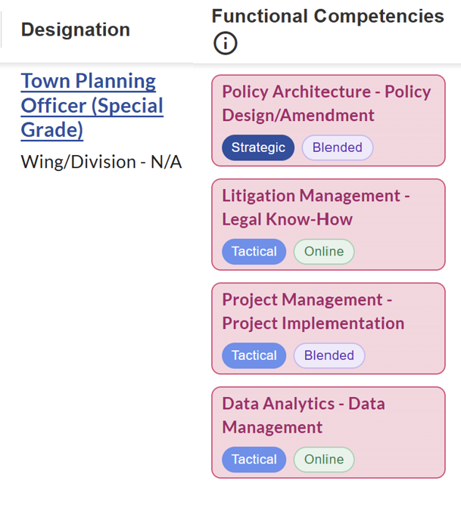
Different Competency Levels for same designation (illustrative example)
Both “Strategic” and “Tactical” level competencies recommended for Town Planning Officer – based on the requirement of the role as per uploaded resources

Slide 9
Delivery mode: 4 lenses to shape the recommendation
01
Learning requirement
Nature of the competency
Knowledge or practical application
Need for facilitation, feedback or field exposure
03
Target Cadre
Actual number and distribution of learners
A designation or CBP row may represent a large cadre
Opportunity cost and time away from work
02
Role in context
Responsibilities and work situations
Operational, Tactical or Strategic application
Seniority provides context but does not decide
04
Delivery System
ATI or departmental institute mandate
Trainers, centres, equipment and infrastructure
Batch, decentralised or master-trainer delivery

Slide 10
Delivery mode follows the learning requirement
Can the learner become competent through digital learning, or is live practice and feedback essential?
ONLINE
OFFLINE
Use when the essential outcome can be achieved digitally
Use when competency depends on live or supervised application
Standardised knowledge
Rules, policies, schemes and SOPs
Concepts, demonstrations and assessments
Large distributed cadres
Role-play, coaching and reflection
Hands-on practice or equipment use
Simulation, feedback and peer learning
Laboratory or field exposure
BLENDED
e.g Functional competencies when digital knowledge and structured practice are both indispensable

Slide 11
Why context matters - examples
Illustrative competency | Type | Recommended mode | Why
Scheme guidelines and eligibility | Domain | Online | Rules and concepts can be learned and assessed digitally at scale
Citizen grievance handling | Behavioural | Offline | Role-play, observation and feedback are essential
Operation of field equipment | Functional | Offline | Hands-on demonstration and supervised practice are critical
Using a departmental digital system | Functional | Blended | Online orientation plus guided practice and troubleshooting
District programme planning | Functional | Blended | Online frameworks plus facilitated planning and peer review
Emergency response coordination | Functional | Offline | Simulation, drills and team feedback are indispensable
Role of State training institutions
Use Online learning for common prerequisites and refreshers
Use batches, decentralised centres and master trainers to deliver practice at scale
Reserve face-to-face time for simulation, coaching, field application and assessment

Slide 12
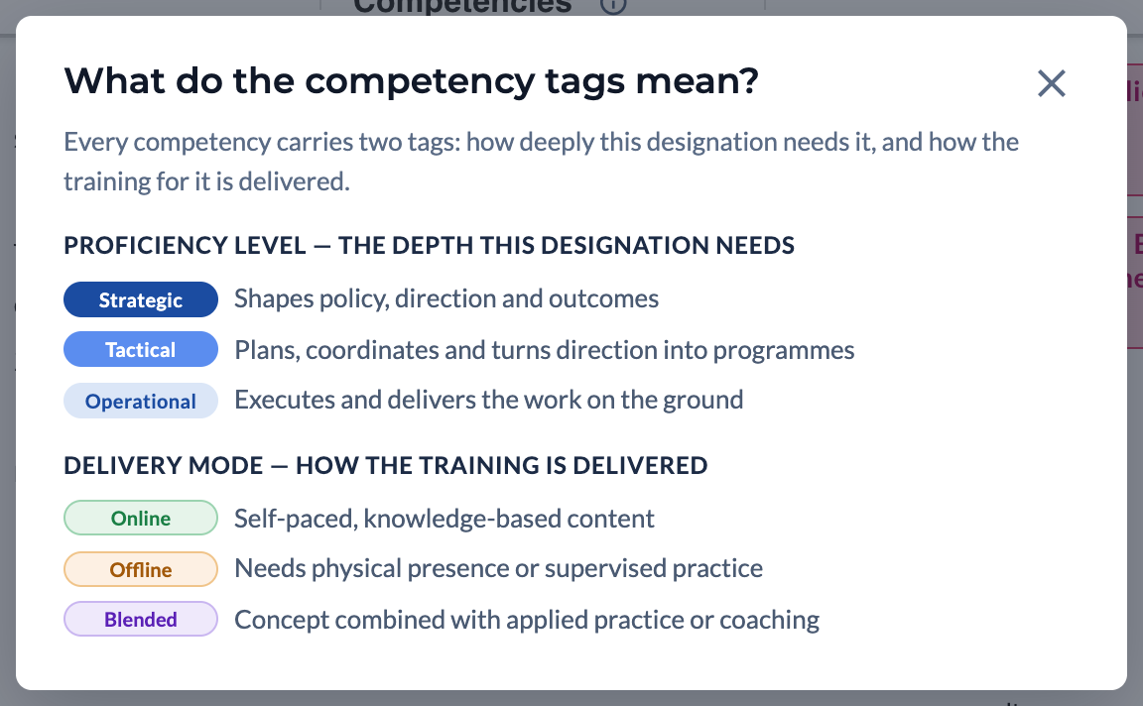
Tag explanation on the UI
An info icon sits on each of the three competency column headers.
Opening it shows what every tag means, with each badge in its real styling, so the panel is also the colour key.

Slide 13


Course Recommendation & Gap Analysis
Competency
Course
Area, theme, sub-theme + STO level
Area, theme, sub-theme + STO level
A competency counts as a gap when the designation needs it but no recommended course for that role mapping is tagged to it.

Slide 14
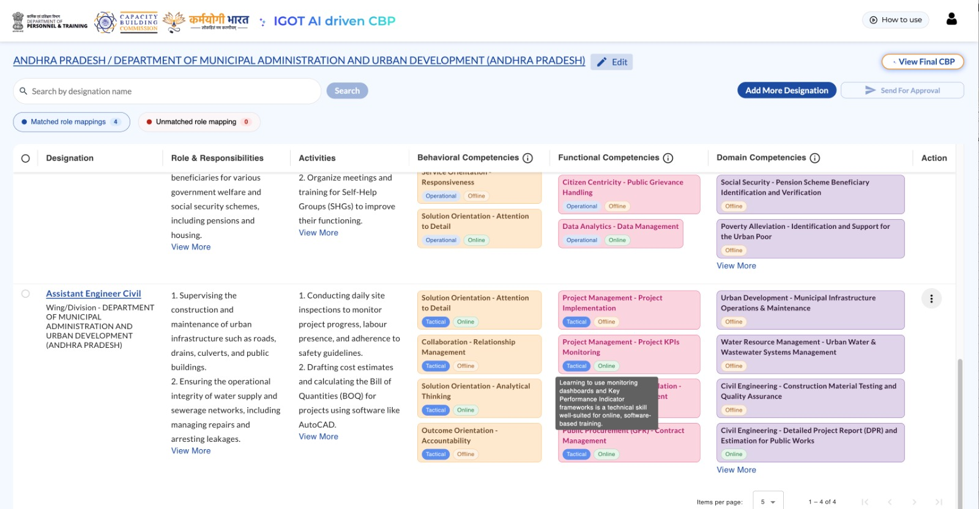
Illustrative

Slide 15
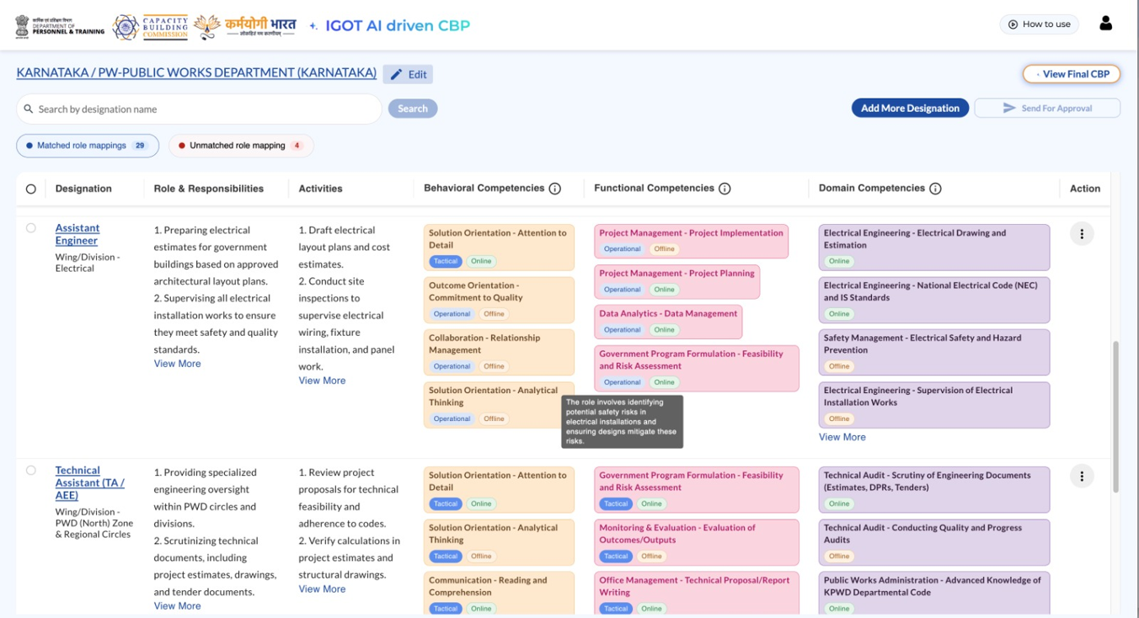
Illustrative

Slide 16
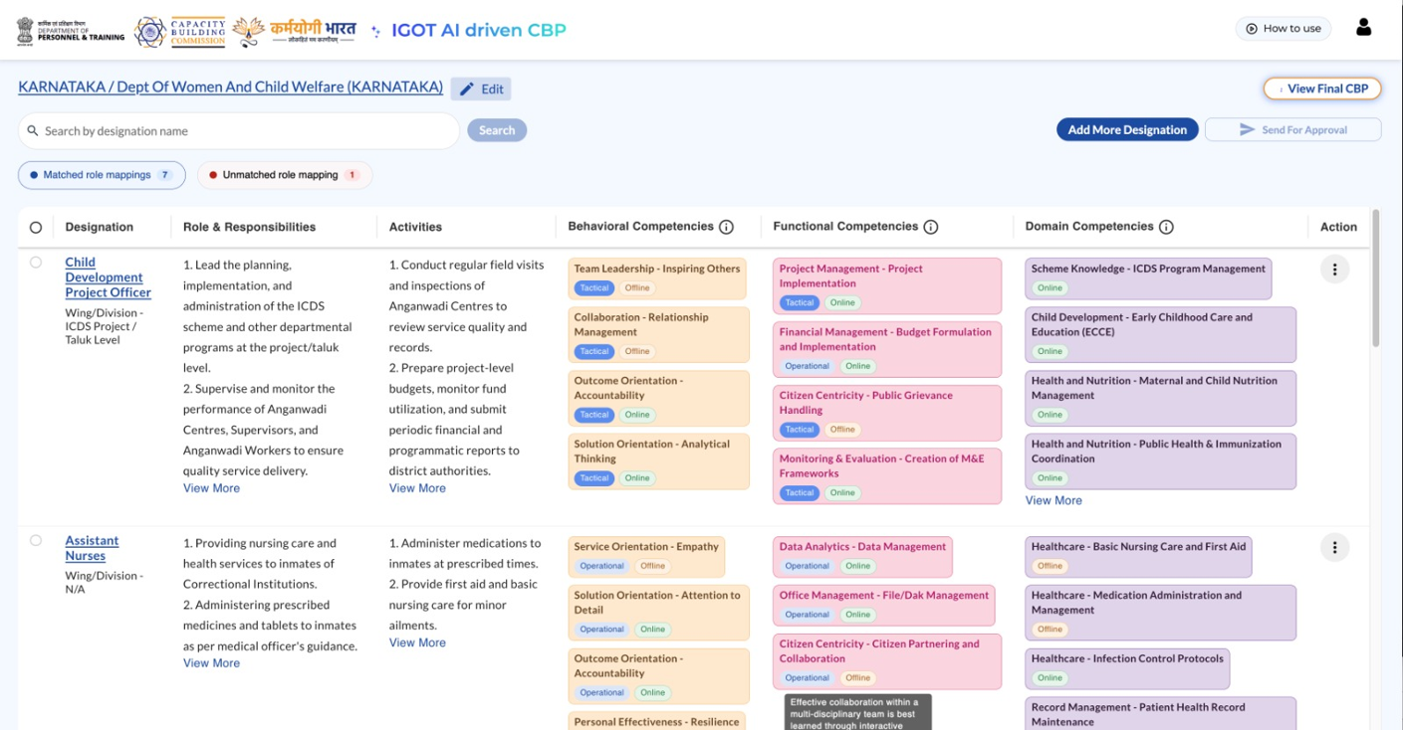
Illustrative

Slide 17
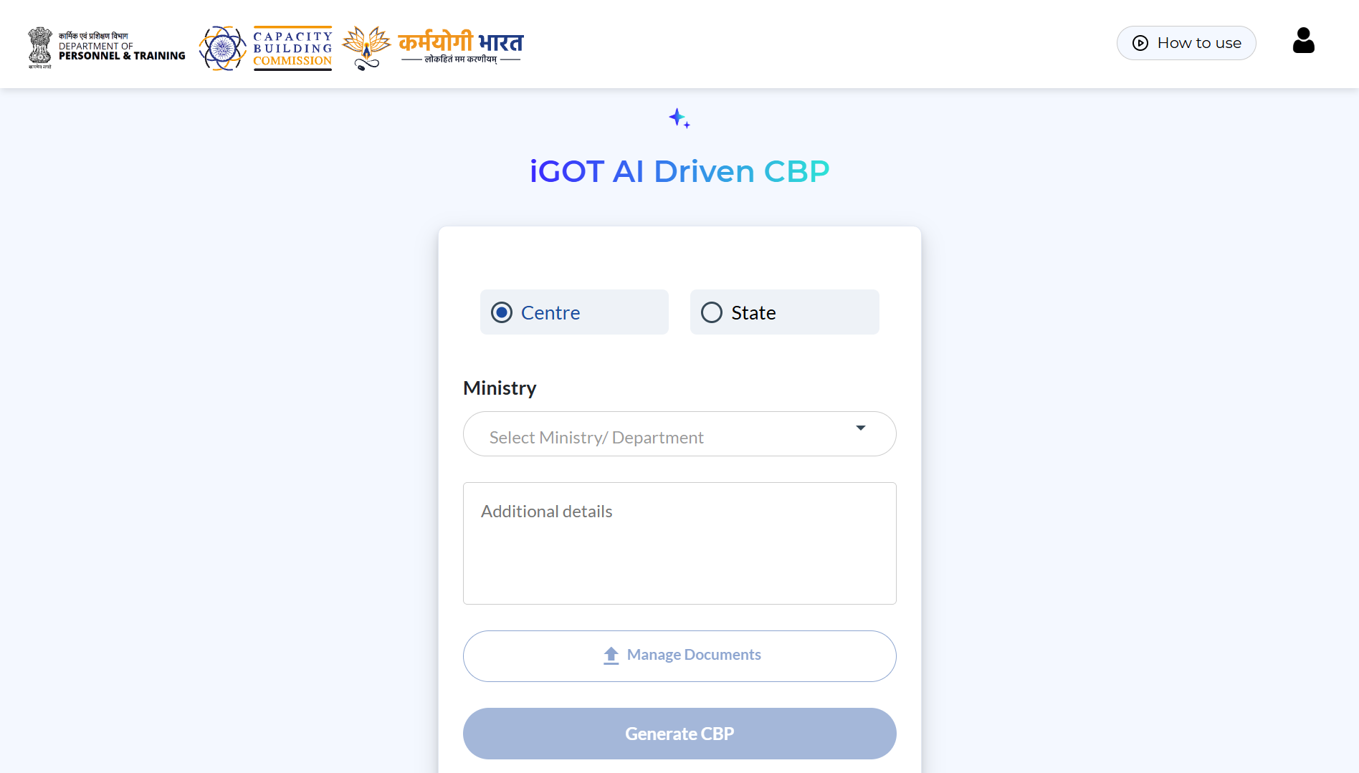

Generated Competency Recommendations to UNNATI
Competency Area, theme & sub-theme
Proficiency Level: S-T-O
Delivery Mode: Online / Offline / Blended
Comprehensive Training Institutes’ profile → Capacity Building Plan for Training Institute

Slide 18
THANK YOU

