Slide 1





Karmayogi Kartavya Karyakram
KARMAYOGI KARTAVYA KARYAKRAM · REGIONAL WORKSHOP
1 / 13
Notes:
Open with energy. Do not explain the programme yet — signal that officers will DO something. Keep this to under 60 seconds.

Slide 2

KARMAYOGI KARTAVYA KARYAKRAM
Let's Create Groups
We will gather you in random groups of 5-6 members for this activity.
GROUP STRUCTURE & COMPOSITION
Member 1
Member 2
Member 3
Member 4
Member 5
KARMAYOGI KARTAVYA KARYAKRAM · REGIONAL WORKSHOP
2 / 13

Slide 3
KARMAYOGI KARTAVYA KARYAKRAM
Think of a Moment
THINK — SILENT — 1 MIN
IT COULD BE A MOMENT WHERE YOU...
Helped someone in real difficulty
Felt genuinely proud of work you did
Rose to a challenge and overcame it
Applied your knowledge to crack a hard problem
Found an innovative solution to a tough issue
Achieved a difficult goal by working with others
Acted with integrity despite real pressure
Made a decision whose impact outlasted your posting
Led a reform through real institutional resistance
Or any other moment that comes to mind
Close your Eyes.. Individually and silently, think of one incident from your work that gave you a deep sense of satisfaction and fulfilment.
Hold that one moment in mind. Remember how you felt
KARMAYOGI KARTAVYA KARYAKRAM · REGIONAL WORKSHOP
Notes:
Give real silence here — 90 seconds to 2 minutes, no talking. This single slide carries the full weight of the story-recall step; do not rush it.

Slide 4
KARMAYOGI KARTAVYA KARYAKRAM
SHARE — 5 MIN
A Moment That Made a Difference
Share the story in following manner:
01
02
03
04
What was the situation?
What did you achieve?
(the visible outcome)
Who benefited from it?
(Yourself, citizens, colleagues, junior, senior, etc.)
What did the experience give you?
Why do you remember this story
Share your story within your group. One member at a time - each member gets 1 min — describe the moment, what you did, and the feeling it gave you.
KARMAYOGI KARTAVYA KARYAKRAM · REGIONAL WORKSHOP
Notes:
THINK (1 min): give a silent moment, do not rush it. SHARE (5 min): groups of 3-4, everyone gets a turn to share their moment briefly.

Slide 5
KARMAYOGI KARTAVYA KARYAKRAM
DISCUSS — 3 MIN
Select Your Story
Step 1: Select one story from your team
Discuss to select any one story shared in part 1 of this exploration.
BASIS FOR SELECTION
Feeling & Personal Fulfillment
Impact & Reach
The feeling of achievement, appreciation, satisfaction, fulfilment etc. experienced in the story.
The impact it made on yourself and others (citizens, colleagues, junior, senior, etc.).
KARMAYOGI KARTAVYA KARYAKRAM · REGIONAL WORKSHOP

Slide 6
KARMAYOGI KARTAVYA KARYAKRAM
CHART PAPER — 4 MIN
Chart the Story
Step 2: Turn that story into your chart
THINK COLLECTIVELY AND FILL IN:
What was the situation ? Write minimum 3 inputs each
Visible Impact
Internal Impact
KARMAYOGI KARTAVYA KARYAKRAM · REGIONAL WORKSHOP
Notes:
CREATE (4 min): groups pick ONE story (most fulfilling + clearest impact), sketch a tree on chart paper, and label Outer Fruit / Inner Fruit / Joy of Contribution together. Circulate and prompt groups that are stuck.

Slide 7

KARMAYOGI KARTAVYA KARYAKRAM · REGIONAL WORKSHOP
7 / 13
Notes:
CREATE (4 min): groups pick ONE story (most fulfilling + clearest impact), sketch a tree on chart paper, and label Outer Fruit / Inner Fruit / Joy of Contribution together. Circulate and prompt groups that are stuck.

Slide 8
KARMAYOGI KARTAVYA KARYAKRAM
Any two or more teams may come and present the chart paper
PRESENTATION FLOW & SUGGESTIONS
Member 1
Shares the story, briefly
Member 2
What was achieved
1
2
Member 3
Visible Impact
Member 4
Invisible Outcome
3
4
Member 5
Special input, then open floor
All Participants
Share any other impact they think the storyteller experienced
5
ALL
KARMAYOGI KARTAVYA KARYAKRAM · REGIONAL WORKSHOP
Notes:
PRESENT (1-2 min): call on 1-2 groups only — do not go around the room. Hold them to 3 minutes. Thank every group even if they don't present.

Slide 9

KARMAYOGI KARTAVYA KARYAKRAM
Special Input
“If you were the beneficiary of the story…”
Think what impact it would have made on you?
KARMAYOGI KARTAVYA KARYAKRAM · REGIONAL WORKSHOP
Notes:
Ask the question aloud, then hold 15–20 seconds of real silence — do not rush to the reveal. This is the first of three individual reflections; set an unhurried pace here since the room will follow it for the next two.

Slide 10
KARMAYOGI KARTAVYA KARYAKRAM
Special Input
“If you were the beneficiary of the story…”
Think what impact it would have made on you?
KARMAYOGI KARTAVYA KARYAKRAM · REGIONAL WORKSHOP
Notes:
Ask the question aloud, then hold 15–20 seconds of real silence — do not rush to the reveal. This is the first of three individual reflections; set an unhurried pace here since the room will follow it for the next two.

Slide 11



KARMAYOGI KARTAVYA KARYAKRAM
Special Inputs
Reflect on the storyteller’s experience of fulfilment.
01 ·
02 ·
03 ·
How often do we experience such moments of fulfilment in our own work?
What would change if we created more such moments in our everyday work?
How might these moments influence the way we work and the impact we create?
KARMAYOGI KARTAVYA KARYAKRAM · REGIONAL WORKSHOP
Notes:
Ask, pause, reveal — same rhythm. This is the last of the three individual reflections before the closing beat.

Slide 12

KARMAYOGI KARTAVYA KARYAKRAM
Discussion
CLASS DISCUSSION
Look at your chart papers carefully.
Did you notice any common outcomes or achievements across the stories shared during the presentation?
Sharing A few participants may share their observations with the room.
KARMAYOGI KARTAVYA KARYAKRAM · REGIONAL WORKSHOP
Notes:
A show of hands only — no need to discuss answers aloud or call on anyone. Keep this brief; it leads straight into the Takeaway slide.

Slide 13

What Did We Just Experience?
~1-2 min
A real experience.
A story.
Its impact.
What it grew within us.
Peer learning.
Reflective learning
THIS IS BEHAVIOURAL REFLECTION IN ACTION.
KARMAYOGI KARTAVYA KARYAKRAM · REGIONAL WORKSHOP

Slide 14
Karmayogi Kartavya Karyakram
KARMAYOGI KARTAVYA KARYAKRAM · REGIONAL WORKSHOP
1 / 13
Notes:
Open with energy. Do not explain the programme yet — signal that officers will DO something. Keep this to under 60 seconds.

Slide 15



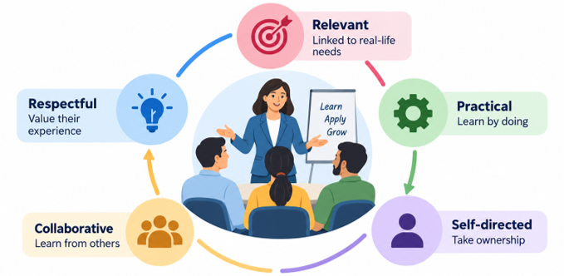
Vision: Why Karmayogi Kartavya Karyakram
VISION
To nurture the culture of Seva Bhav (spirit of service) among public servants by reconnecting their inner purpose with the outer expression of public service.
THE PROGRAMME AIMS TO
Citizen-Centric Service
Responsiveness & Collaboration
Purpose-Driven Service
Vision
RKYP
Programme
Modules
Cascade
Two Tracks
Where It Lives
Rollout
South Cluster
Roles
Our Ask

Slide 16
Where We Began: The Rashtriya Karmayogi Jan Seva Programme
RKYP · MISSION KARMAYOGI
CONCLUDED 10 FEBRUARY 2026
THE NEXT PHASE
A national behavioural training initiative, primarily for Central Government ministries, departments, organisations and institutions.
Demand to continue
Several Ministries and Departments requested continuation of behavioural capacity building.
Impact assessment
Conducted 90 days after the programme: a significant shift in mindset towards Seva Bhav and a more positive approach to work.
Extends Seva Bhav to every public servant, leveraging the trainer ecosystem created under RKYP.
10.5 lakh
officials trained
State
17,000+
Lead & Master Trainers created
Central
85+
Ministries & Departments covered
The program leverages the trainer ecosystem built under RKYP to scale behavioural training across Central and State Governments.
Vision
RKYP
Programme
Modules
Cascade
Two Tracks
Where It Lives
Rollout
South Cluster
Roles
Our Ask

Slide 17
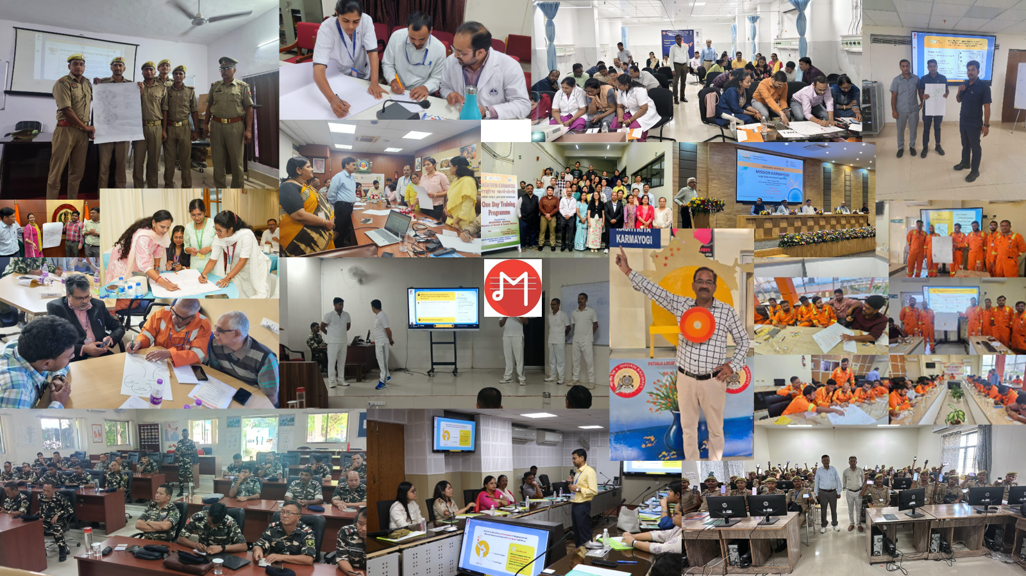

Slide 18
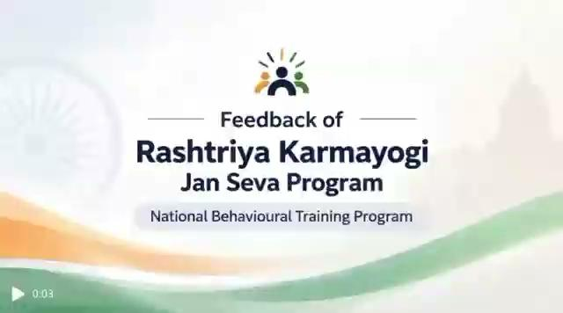
In Their Words: Feedback from RKYP
Feedback video — insert here
(Insert › Video › This Device, resize to fill this frame, then delete this placeholder)
Vision
RKYP
Programme
Modules
Cascade
Two Tracks
Where It Lives
Rollout
South Cluster
Roles
Our Ask
Capacity Building Commission | Government of India | Senior Officers Briefing | South Regional Workshop
05 / 20

Slide 19




What is the Programme?
A BLENDED-LEARNING APPROACH
Behavioural, on-ground training combined with digital learning on iGOT, built on adult learning principles for real behavioural shifts, not just awareness.
Experience-Based Learning
Peer Interaction
Activity-Based Exercises
Reflective Practice
Learning drawn from real-life experience, not lectures.
Collaborative discussion among participants, facilitated not taught.
Hands-on exercises rather than passive listening.
Space to reflect on one's own role in citizen-centric service.
FOUR PROGRAMME COMPONENTS
One-Day Behavioural Training
Master Trainer Programme
Digital Learning (iGOT)
Institutionalisation
4.5 hours · 35–40 per batch
2 days · 35–40 per batch
Self-paced
RKY
All faculty of ATI & DTI shall be trained under the program
Core learning initiative for all target officials
Builds facilitator capacity for cascade delivery
Pre/post reinforcement and a self-learning course
Vision
RKYP
Programme
Modules
Cascade
Two Tracks
Where It Lives
Rollout
South Cluster
Roles
Our Ask

Slide 20
Inside the One-Day Training: The Four Modules
MODULE
PURPOSE
PARTICIPANTS LEAVE ABLE TO…
Who is a Rashtriya Karmayogi?
Builds a shared understanding of the Rashtriya Karmayogi ideal
Share a common understanding of the Rashtriya Karmayogi ideal
1
Expanding Our Vision of Success and Fulfilment
Widens what “success” and “fulfilment” can mean through one's work
See the wider success and fulfilment possible through work, and awaken the intent to serve
2
Creating Karmayogi Moments
A simple, practical technique participants can use immediately
Translate the Karmayogi ideal into everyday work with a simple technique
3
The Rashtriya Karmayogi as a Nation-Builder
Connects the individual's daily role to the larger national mission
Connect their role to ministry objectives, national goals and citizens
4
4.5 hours · each module builds on the last — a journey of self-discovery and application
Vision
RKYP
Programme
Modules
Cascade
Two Tracks
Where It Lives
Rollout
South Cluster
Roles
Our Ask

Slide 21
How to reach frontline officials: Cascade Trainer Model
1
2
3
4
5
National Lead Trainers
Initial SMT Cohort
State Lead Trainers
Expanded SMT Cohorts
Frontline Officials
NLTs
State Master Trainers
SLTs
State Master Trainers
Target participants
WHO
WHO
WHO
WHO
WHO
RKYP trainer pool · 1 pair per ATI
~40 from ATI / DTI faculty (large states: more cohorts)
Auto-certified SMTs
Nominated by departments, ATIs and training institutions
~1 crore nationally: Police, Teachers, Health Workers
ROLE
ROLE
ROLE
ROLE
ROLE
Run the 2-day Master Trainer Programme for the initial SMT cohort
Deliver one-day the program sessions
Train further SMT cohorts through the 2-day programme (in pairs)
Deliver one-day sessions to state officials and frontline workers
Attend the 4.5-hour one-day programme
NOTE
HOW THEY MOVE ON
HOW THEY MOVE ON
HOW THEY MOVE ON
BATCH
Always train in pairs
After 3 one-day batches → auto-certified as SLTs
Anchor expansion of the state trainer ecosystem
Min. 3 batches each ≈ 90–105+ officials
35–40 per batch
Trainer formula: SMTs needed = (Officials ÷ Batch size) ÷ Batches per SMT | Min. 3 batches per SMT ≈ 90–105+ officials | ~1 lakh SMTs needed nationally
Vision
RKYP
Programme
Modules
Cascade
Two Tracks
Where It Lives
Rollout
South Cluster
Roles
Our Ask

Slide 22
How Implementation Works: Central + State Tracks
Departmental institutes onboard existing RKYP trainers, running in parallel across Central MDOs.
ATI is the nodal institution, beginning with the SMT cohort; DTIs / Departments support delivery of the one-day programme.
CENTRAL GOVERNMENT TRACK
STATE GOVERNMENT TRACK
Existing RKYP Trainer Pool
National Lead Trainers (NLTs)
Lead Trainers & Master Trainers already trained and certified
Seed the initial State Master Trainer cohort
↓
↓
One-Day the program
State Master Trainers (SMTs)
For Central Government officials not yet covered under RKYP
~40 per state, drawn from ATI/DTI faculty
↓
↓
Departmental Training Calendars
State Lead Trainers (SLTs)
Integrated into Foundation, Induction, Mid-Career and In-Service programmes
Auto-certified after 3 successful one-day batches
↓
↓
Central / Departmental Rollout
Expansion via ATIs / DTIs / Departments
Sustained through institutions' own existing training systems
Wider trainer ecosystem delivers at scale statewide
↓
Central + State Trainer Pools
→
Trainer Certification
→
One-Day Program
→
Institutionalisation
Vision
RKYP
Programme
Modules
Cascade
Two Tracks
Where It Lives
Rollout
South Cluster
Roles
Our Ask

Slide 23
Where Can the Programme Live in Your Institution?
Foundational Training
Induction Training
Mid- Career Training
Leadership Program
Collective Reflection
Core module for newly recruited personnel
First-week orientation for newly appointed officials
Refresher and advanced behavioural module
A behavioural anchor in senior leadership development
Samuhik Charcha sessions that sustain peer reflection
In-Service / Dept. Training
Periodic one-day sessions in departmental calendars
Specialised / Sectoral
Contextualized delivery in domain academy curricula
Existing Training Calendar + Program Behavioural Component = Institutionalisation. The program builds the capacity of the faculty of ATI/DTI .
Vision
RKYP
Programme
Modules
Cascade
Two Tracks
Where It Lives
Rollout
South Cluster
Roles
Our Ask

Slide 24
National rollout: four phases to universal State coverage by December 2028
Phase 1
Phase 2
Phase 3
Phase 4
Apr – Sep 2026
Oct 2026 – Mar 2027
By Dec 2027
By Dec 2028
SMT training by NLTs begins; initial rollout of one-day the program
Trainer networks expand; SLTs auto-certified from SMTs; SLTs train further SMTs
Priority frontline sectors covered: Teachers, Health Workers, Police
Universal coverage of State Government officials; the program institutionalised in state training systems
TARGET · PHASE 1–3, BY DECEMBER 2027
WHERE WE ARE
~1.3 crore
~1 crore
State frontline officials (Police, Teachers, Health Workers)
+ ~30 lakh
Central officials not covered under RKYP
20
States / UTs onboarded
1,300+
State Master Trainers trained
~1 lakh trainers across the cascade · ~3 lakh training batches · Universal State coverage by 2028
~5,000
one-day participants trained
Vision
RKYP
Programme
Modules
Cascade
Two Tracks
Where It Lives
Rollout
South Cluster
Roles
Our Ask

Slide 25
In South Cluster: 22.5 Lakh Target
 | TARGET |  |  |  |  | CURRENT STATUS
State / UT | Frontline officials |  | SMTs needed | SMT batches | ≈ Batches / month | SMTs trained | SLTs certified | One-day participants
Odisha | 4,47,573 |  | 3,730 | 107 | 22 | 87 | 2 | 30
Karnataka | 4,42,466 |  | 4,214 | 121 | 25 | 100 | 0 | 350
Tamil Nadu | 4,19,977 |  | 4,000 | 120 | 23 | 0 | 0 | 0
Andhra Pradesh | 4,12,182 |  | 3,926 | 113 | 23 | 28 | 0 | 280
Telangana | 2,93,985 |  | 2,800 | 80 | 16 | 0 | 0 | 0
Kerala | 2,23,107 |  | 2,125 | 61 | 13 | 32 | 0 | 0
Puducherry | 9,371 |  | 90 | 3 | 1 | 0 | 0 | 0
South Cluster | 22,48,661 |  | 20,885 | 600 | 123 | 249 | 2 | 660
Estimates cover frontline workers only; State Government officials will also be covered under the programme.
Vision
RKYP
Programme
Modules
Cascade
Two Tracks
Where It Lives
Rollout
South Cluster
Roles
Our Ask

Slide 26

Feedback of Program : South Cluster
Feedback video — insert here
(Insert › Video › This Device, resize to fill this frame, then delete this placeholder)
Vision
RKYP
Programme
Modules
Cascade
Two Tracks
Where It Lives
Rollout
South Cluster
Roles
Our Ask
Capacity Building Commission | Government of India | Senior Officers Briefing | South Regional Workshop
14 / 20

Slide 27
In South Cluster today
SMTs trained against each State/UT's own SMT requirement
249
Each bar = 100% of that State/UT's requirement. Filled portion = SMTs trained so far.
State Master Trainers trained
Odisha
87 of 3,730
of 20,885 needed across the cluster
Karnataka
102 of 4,214
2
Tamil Nadu
0 of 4,000
State Lead Trainers certified
Andhra Pradesh
28 of 3,926
the first step of the in-state cascade
Telangana
0 of 2,800
233
Kerala
32 of 2,125
one-day participants
trained in one-day sessions so far
Puducherry
0 of 90
Source-table order, not ranked. One colour only: the chart shows where each State/UT is starting from, not performance.
Vision
RKYP
Programme
Modules
Cascade
Two Tracks
Where It Lives
Rollout
South Cluster
Roles
Our Ask

Slide 28
Roles and Responsibility
Institution
Role
What This Looks Like
State ATI / Training Institution
Nodal · Coordinate · Build Trainer Ecosystem
Nominate SMTs from faculty → Host the 2-day Master Trainer Programme → Coordinate rollout and sustain the trainer pipeline
General Administration Department
Coordinate · Direct · Monitor
Coordinate departments for implementation with the ATI → Direct departments to participate and nominate → Monitor progress and timelines
Central Training Institute
Leverage · Integrate · Deliver
Leverage existing RKYP trainer capacity → Integrate the program into Foundation, Induction and Mid-Career programmes
Departmental Training Institute
Contextualise · Deliver · Reinforce
Adapt the message to sector context (policing, health, forests, security, revenue) → Embed it in in-service training calendars
State Master Trainers
Facilitate · Cascade · Mentor
Facilitate one-day sessions → Cascade the trainer pipeline → Mentor emerging trainers
Vision
RKYP
Programme
Modules
Cascade
Two Tracks
Where It Lives
Rollout
South Cluster
Roles
Our Ask

Slide 29
What we need from you next
1
2
3
4
5
PLAN
BUILD TRAINER CAPACITY
CREATE THE SLT PIPELINE
DELIVER ON iGOT
EMBED IN EXISTING SYSTEMS
GAD & ATI
ATIs & DTIs
ATIs & SMTs
All implementing institutions
ATIs, DTIs & CTIs
Prepare a State/UT implementation plan
Train all your faculty as State Master Trainers
Build a cohort of State/UT Lead Trainers
Conduct the programme on the iGOT Karmayogi platform
Build program into foundation, induction, mid-career and in-service calendars
Based on target one-day participants: State Government officials and frontline workers
Conduct additional SMT batches in the ATIs
SMTs who complete 3 batches become SLTs, who can cascade and conduct SMT batches
Onboarding, training records, certification and monitoring on one platform
Samuhik Charcha ~6 months after training sustains the learning
This program not only strengthens not only behavioural competencies but also the delivery capabilities of faculty at ATIs/DTIs, enabling them to effectively facilitate and cascade learning to civil service personnel.
Vision
RKYP
Programme
Modules
Cascade
Two Tracks
Where It Lives
Rollout
South Cluster
Roles
Our Ask

Slide 30
Faculty Development Program
For faculty capacity development we have a dedicated program.
The Capacity Building Commission strengthens state capacity by empowering Civil Service Training Institutions' faculty through the Faculty Development Program (FDP).
The FDP combines an online self-paced module with a 5-day intensive in-person program in collaboration with Indian School of Business.
2800+
Completions
of online self-paced FDP program on iGOT
600
Faculty Target
Training over the next 3 years through a 5-day in-person program
357
Trained Till Date
Successfully completed across 10 batches

Slide 31
South Cluster : FDP Current Status
Current Status
Ministry/State | Organisation Name | Participation (Batch 1-11) | Nominations (Batch 12-14)
Andhra Pradesh | Andhra Pradesh Human Resource Development Institute (APHRDI) | 0 | 0
Karnataka | Administrative Training Institute (ATI), Mysore, Karnataka | 0 | 0
Kerala | Institute of Management in Government (IMG), Kerala | 0 | 0
Odisha | Gopabandhu Academy of Administration (GAA), Odisha | 1 | 0
Tamil Nadu | Anna Administrative Staff College (AASC), Tamil Nadu | 0 | 0
Telangana | Dr. MCR HRD Institute of Telangana (MCRHRDIT) | 2 | 1
FUTURE BATCHES
BATCH CALENDAR — Advanced FDP 2025–27
Quarter / Status | Batch | Programme End | Location
Q4 2026-27 | Batch 20 | 22nd January 2027 | ISB Hyderabad
Q4 2026-27 | Batch 16 | 5th Feb 2027 | ISB Mohali
Q4 2026-27 | Batch 17 | 12th February 2027 | ISB Mohali
Q4 2026-27 | Batch 18 | 5th March 2027 | ISB Mohali

Slide 32
Karmayogi Kartavya Karyakram
Sādhana Shrinkhala
SEVA BHAV
Capacity Building Commission · Government of India
Over to the technical session — 15 minutes

Slide 33
TECHNICAL SESSION
Karmayogi Kartavya Karyakram
STATE MASTER TRAINER WORKSHOP
Batch Creation & Participant Enrolment on iGOT Karmayogi
Create
Configure
Generate QR
Enrol
Verify
Capacity Building Commission
Mission Karmayogi | Government of India
Capacity Building Commission | Technical Session

Slide 34
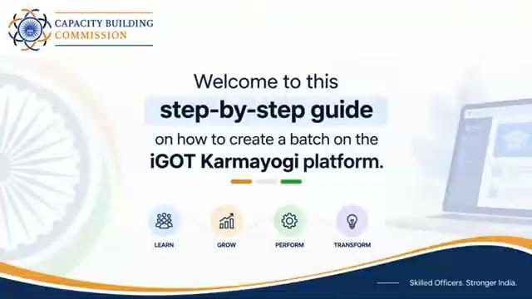

Slide 35





SESSION
Session Outcomes
By the end of the session, participants should be able to perform the complete operational workflow.
01
02
03
04
05
Create a Batch
Configure Location
Enable Self-Enrolment
Enrol Participants
Ensure Baseline Survey & Assessment
Navigate to the Content Portal, open the programme and create a batch with all mandatory fields.
Identify the correct venue coordinates using Google Maps and record them accurately.
Keep Enable QR selected, generate the self-enrolment QR and understand geo-fencing.
Use QR self-enrolment and understand nomination/request-based enrolment workflows.
Confirm learners from the batch and ensure baseline survey and assessment are completed.
Session focus: practical execution, common checks, and facilitator responsibilities.
Karmayogi Kartavya Karyakram | Technical Session

Slide 36

ROLES
State Master Trainer: Two Core Responsibilities
The technical session is built around two operational tasks.
TASK 1
TASK 2
Batch Creation
Participant Enrolment
Create the programme batch, enter the mandatory details, configure the venue location and keep Enable QR selected.
Enable participants to join the batch and manage enrolment through the available workflows.
OPERATIONAL SEQUENCE
Create Batch
Verify Venue
Generate QR
Enrol Participants
Verify Learners
Key principle
Batch configuration and participant enrolment are linked through the batch location and QR settings.
Karmayogi Kartavya Karyakram | Technical Session

Slide 37
WORKFLOW
End-to-End Technical Workflow
Use this as the live-session roadmap.
1
2
3
4
Login to iGOT
Manage Your Program
Create Batch
Configure
Open Content Portal
Open Karmayogi Kartavya Karyakram
Actions › Create Batch
Mandatory details + location + Enable QR
5
6
7
8
Add Batch
Self Enrolment
QR
Participants
Review › Add batch
Open batch › Self Enrolment
Generate › Download › Share on programme day
Enrol › Scan QR › Baseline › Assessment
Steps 1–4 Batch creation Steps 5–8 Enrolment & QR

Slide 38





BATCH CREATION
Batch Creation — Rules to Get Right
These checks prevent duplicate batches, incorrect geo-fencing and failed self-enrolment.
Unique Batch Name
Mandatory Fields
Enable QR
Use a unique {SMT’s Name_[State Name]_[District]_[Venue]_[Date of the Program (dd.mm.yyyy)]}. Avoid duplicate or ambiguous names.
Every field marked (*) must be completed before the batch can be added.
Keep “Enable QR” selected to allow participant self-enrolment through the QR code.
Venue Coordinates
Timing
12 PM Cut-off
Enter the actual programme venue address plus accurate latitude and longitude.
The batch can be created in advance; the QR is shared only on the day of the programme.
Self-enrolment is only possible until 12 PM on the day of the programme.
Remember: the QR is location-tagged. Participants can enrol only when they are physically present at the latitude and longitude recorded for the batch.

Slide 39



ENROLMENT
Participant Enrolment — Three Operational Methods
Use the method applicable to the batch and participant workflow.
METHOD 1
METHOD 2
METHOD 3
QR Scan / Self-Enrolment
Request Learner
Bulk Upload / Nominate Learner
Participant opens the iGOT app, opens the programme, selects Enrol, allows camera access and scans the facilitator’s QR.
The learner submits a request to join; the trainer reviews and approves the request.
Trainer accesses the Learner/Nominate Learner workflow; the participant then completes the enrolment action.
Facilitator responsibility
Know which enrolment method is being used and verify successful enrolment from the batch.

Slide 40
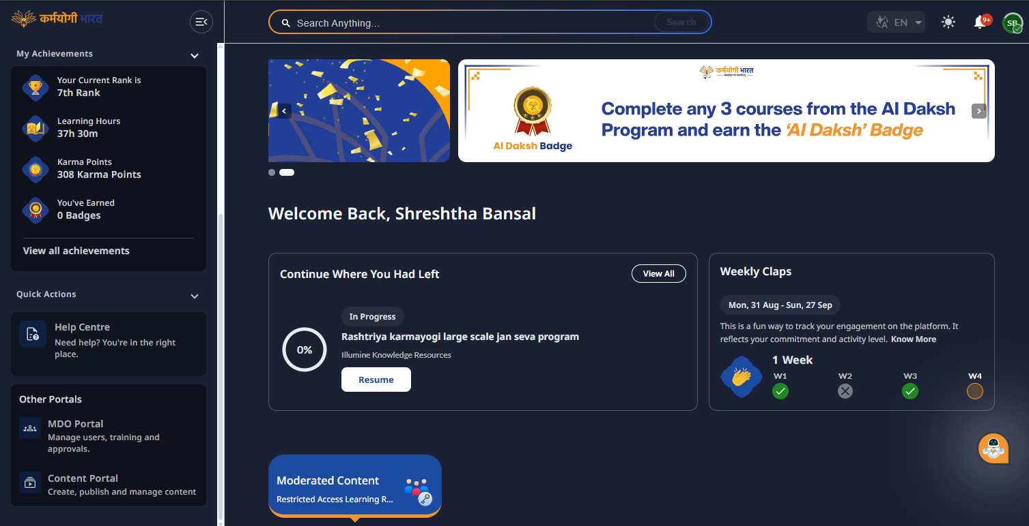

NAVIGATION
Access the Batch Creation Area
Follow the same navigation shown in the screen recording.
1
Log in
Access iGOT on your laptop.
2
Open Content Portal
From the dashboard, select Content Portal.
3
Manage Your Program
Open “Manage Your Program” to reach the programme management area.
The Content Portal is listed under “Other Portals” on the dashboard.

Slide 41
NAVIGATION
Access the Batch Creation Area
Follow the same navigation shown in the screen recording.
1
Log in
Access iGOT on your laptop.
2
Open Content Portal
From the dashboard, select Content Portal.
3
Manage Your Program
Open “Manage Your Program” to reach the programme management area.

Slide 42
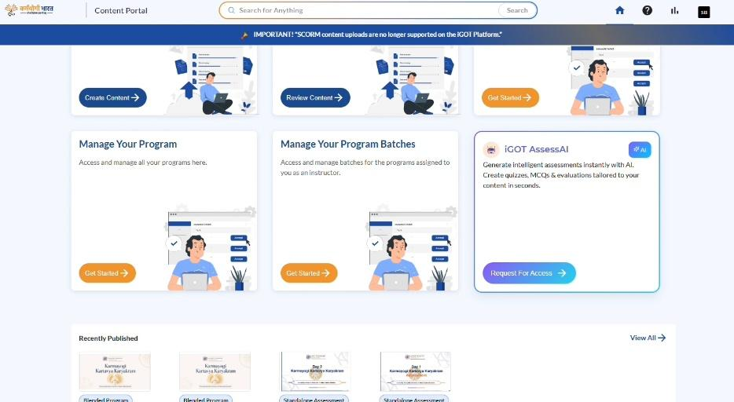
NAVIGATION
Access the Batch Creation Area
Follow the same navigation shown in the screen recording.
1
Log in
Access iGOT on your laptop.
2
Open Content Portal
From the dashboard, select Content Portal.
3
Manage Your Program
Open “Manage Your Program” to reach the programme management area.

Slide 43
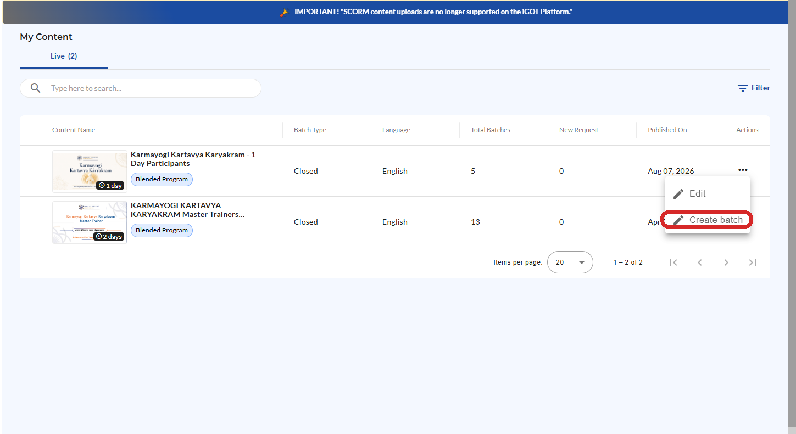

BATCH CREATION
Select the Programme and Create the Batch
Open the programme and use the Actions menu to start batch creation.
1
Open “My Content”.
2
Locate “Karmayogi Kartavya Karyakram – 1 Day Participants”.
3
Open the Actions menu (⋯).
4
Select “Create batch”.
Advance creation
The technical guide notes that the batch can be created 3–4 days before the programme; the QR remains location-tagged.

Slide 44
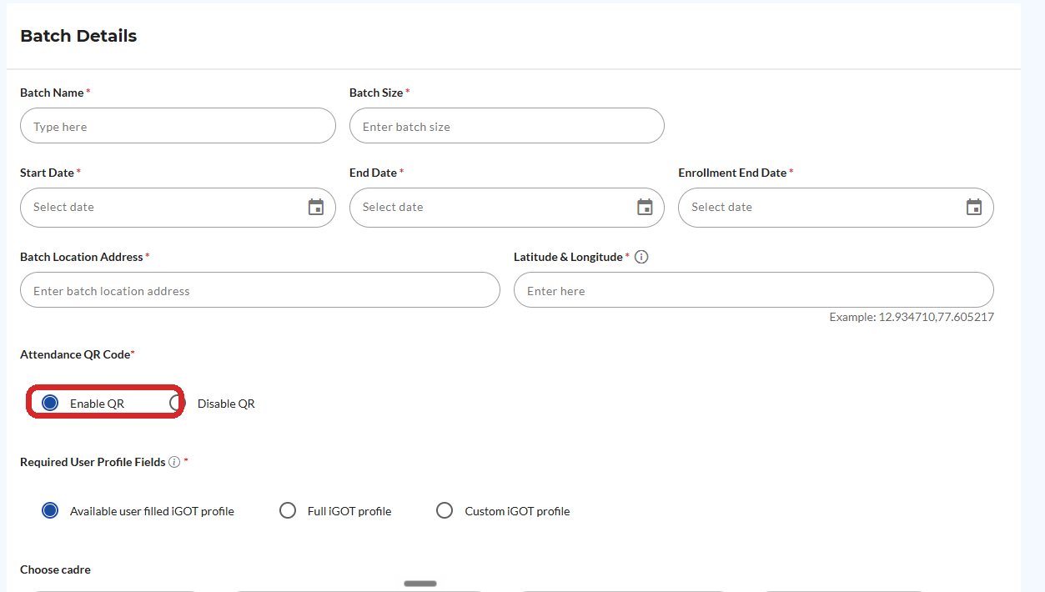

BATCH DETAILS
Complete the Mandatory Batch Details
Enter the fields carefully; the location fields are critical for geo-fencing.
Field | What to enter
Batch Name | {SMT’s Name_[State Name]_[District]_[Venue]_[Date of the Program (dd.mm.yyyy)]}
Batch Size | Planned capacity — recommended 35 to 40 participants only
Start / End Date | Programme dates — same date of the programme
Enrolment End Date | Closing date — same date of the programme
Batch Location Address | Actual venue — full address with Pincode
Latitude & Longitude | Venue coordinates
Attendance QR Code | Keep “Enable QR” selected
Required User Profile Fields | “Available user filled iGOT profile” unless the programme requires another option
Critical check
If Enable QR is not selected, participants cannot self-enrol by scanning the QR code.

Slide 45
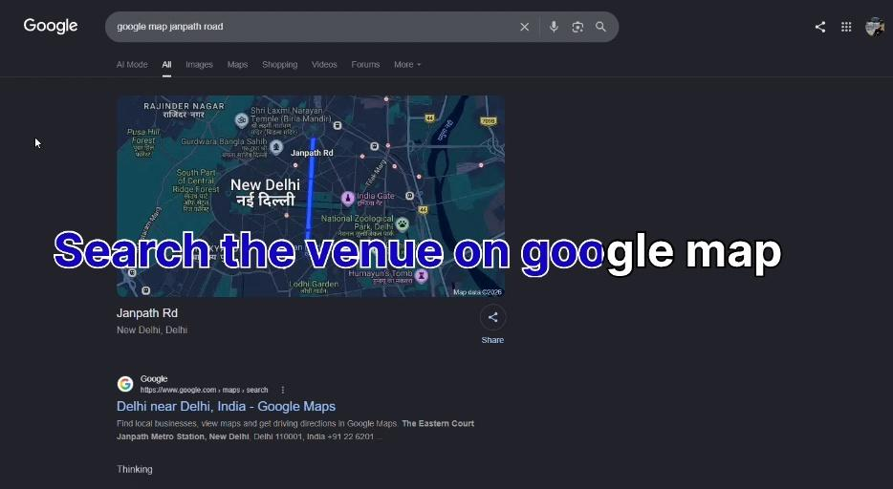
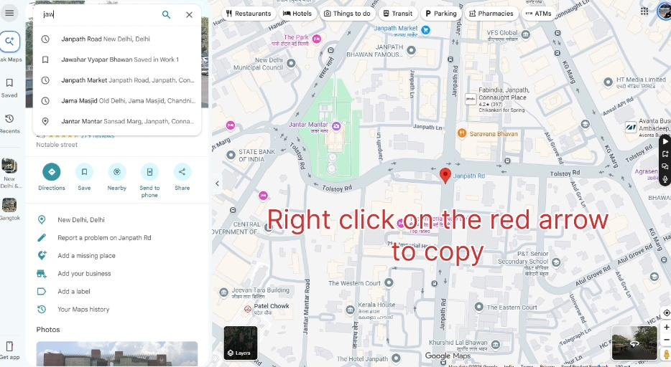
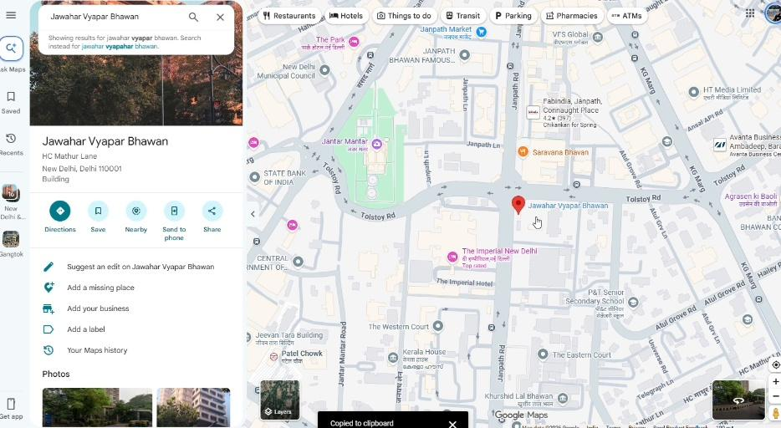
LOCATION
How to Get Latitude & Longitude from Google Maps
Use the exact programme venue — not a nearby landmark or general locality.
1
Search the venue
2
Locate the exact venue
3
Copy the coordinates
GOOGLE MAPS SEQUENCE
Open Google Maps
Search / locate the venue
Right-click the exact location
Read the decimal coordinates at the top
Left-click the coordinates to copy
Paste into Latitude & Longitude

Slide 46


LOCATION
Location Accuracy Is a Technical Control
The coordinates recorded during batch creation determine where QR self-enrolment can occur.
Before clicking Add Batch
Confirm that the address and coordinates correspond to the actual programme venue.
Why it matters
The self-enrolment QR is location-tagged and checks the participant’s physical location.
If coordinates are wrong
Participants may be unable to self-enrol at the intended venue.

Slide 47
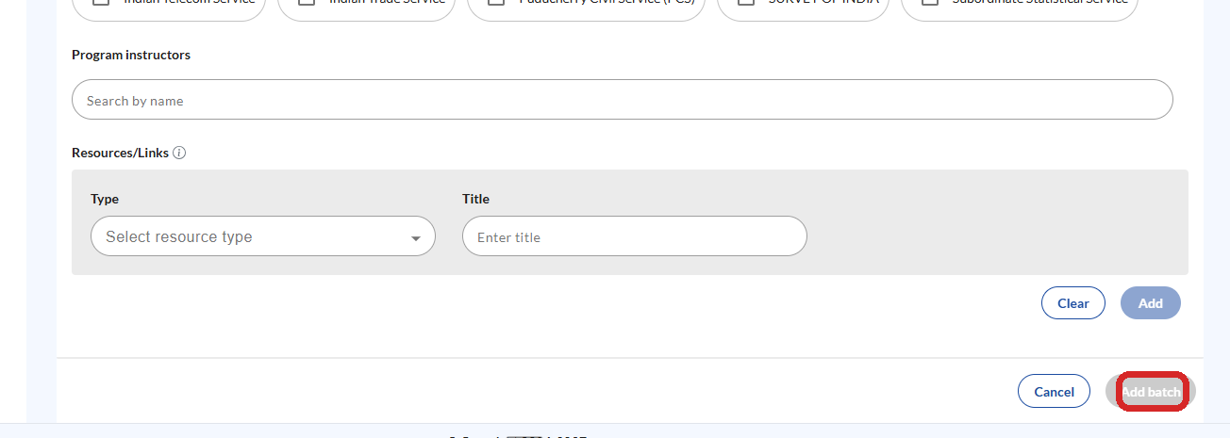
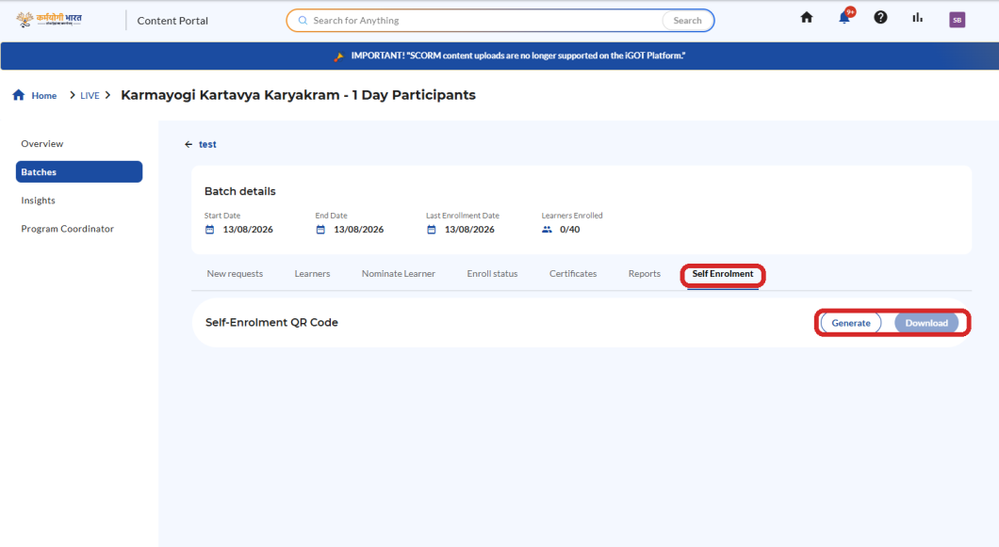

BATCH CREATION
Add the Batch and Open Self Enrolment
Complete the form, create the batch, then move to the Self Enrolment tab.
1
Scroll to the bottom of the form.
2
Select “Add batch”.
3
Optional fields such as Program Instructors and Resources/Links can remain blank unless required.
Operational check
After creation, verify that the correct batch is open before generating the QR.
4
Open the newly created batch.
5
Select the “Self Enrolment” tab.

Slide 48
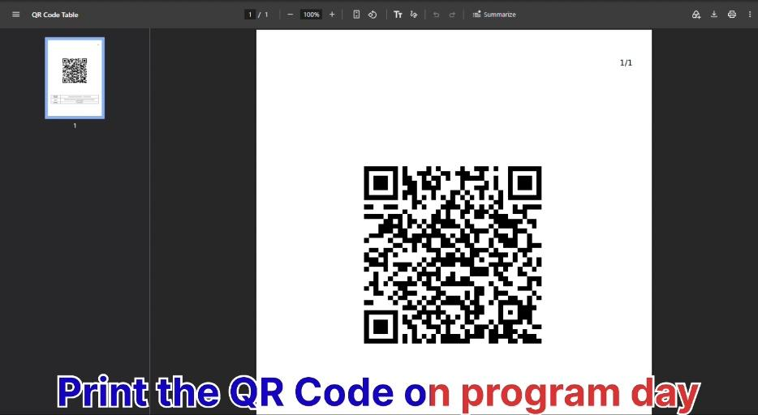



QR CODE
Generate, Download and Share the QR Code
The QR is the bridge between the facilitator’s batch and participant self-enrolment.
Open Self Enrolment
Select Generate, then Download
Verify that the correct QR is being shared

Slide 49



QR CODE
QR Code: Timing, Geo-Fencing & Participant Access
Three rules should be communicated clearly to every facilitator.
WHEN
WHERE
UNTIL WHEN
Share the Self-Enrolment QR only on the day of the programme, at the beginning of the programme.
Participants must be physically present at the latitude and longitude associated with the batch.
Self-enrolment is possible only until 12 PM on the day of the programme.
Do not share an unverified or incorrect QR code.
Before the session starts
Verify the QR, confirm the batch location details, and ensure the facilitator is using the QR generated for the correct batch.

Slide 50


SECTION 2
Participants Enrolment
KARMAYOGI KARTAVYA KARYAKRAM
Three ways to bring participants into the batch
Method 1 QR Scan / Self-Enrolment
Method 2 Request Learner
Method 3 Bulk Upload the Participants/Learner
Capacity Building Commission
Mission Karmayogi | Government of India

Slide 51
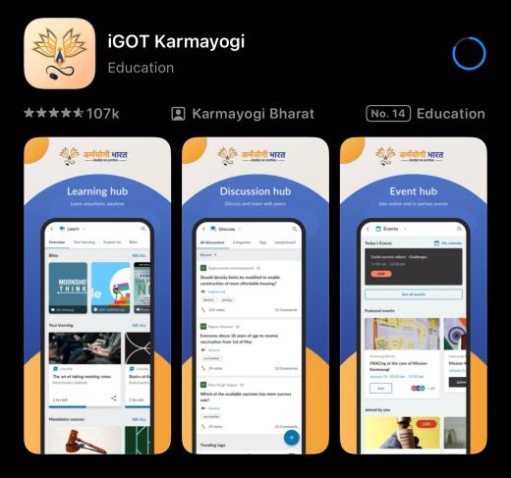
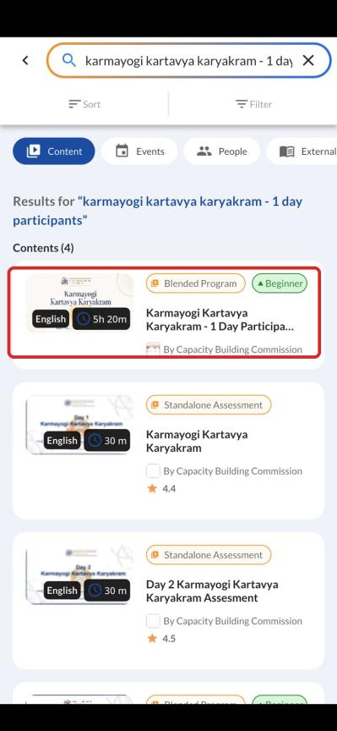
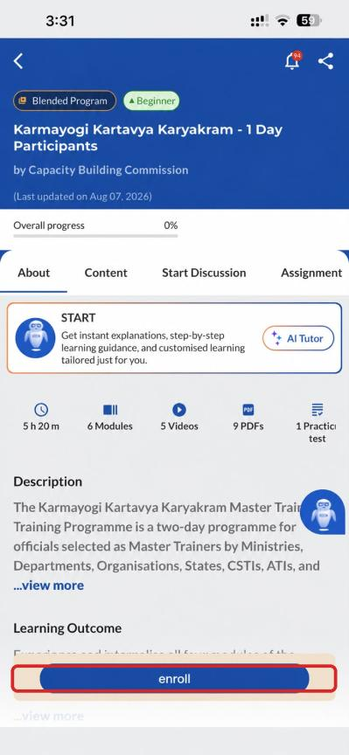

ENROLMENT
Method 1 — QR Scan / Self-Enrolment
Participant workflow on the iGOT mobile application.
1
Open the iGOT app
Sign in on the participant’s mobile device.
2
Find the programme
Search for “Karmayogi Kartavya Karyakram – 1 Day Participants”.
Important
The QR scan should be performed from the iGOT application.
3
Enrol & scan
Select Enrol, allow camera access if prompted, and scan the QR shared by the facilitator.

Slide 52

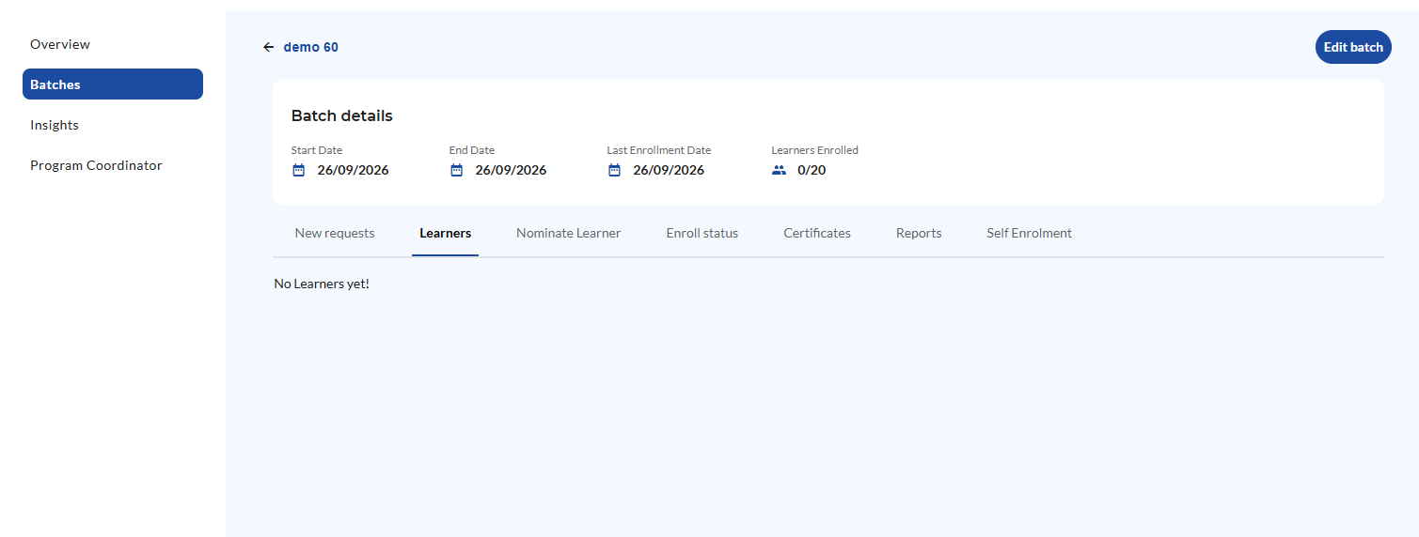
ENROLMENT
Method 2 — Request Learner
Learner-initiated enrolment with trainer approval.
Why use this method? If the QR Code isn't functional this method could be utilised.
1
Learner requests
2
Trainer reviews
3
Approve
The learner submits a request to join the relevant batch.
The trainer checks the New request in the batch management area.
The trainer approves the request and the learner can proceed with the programme.

Slide 53
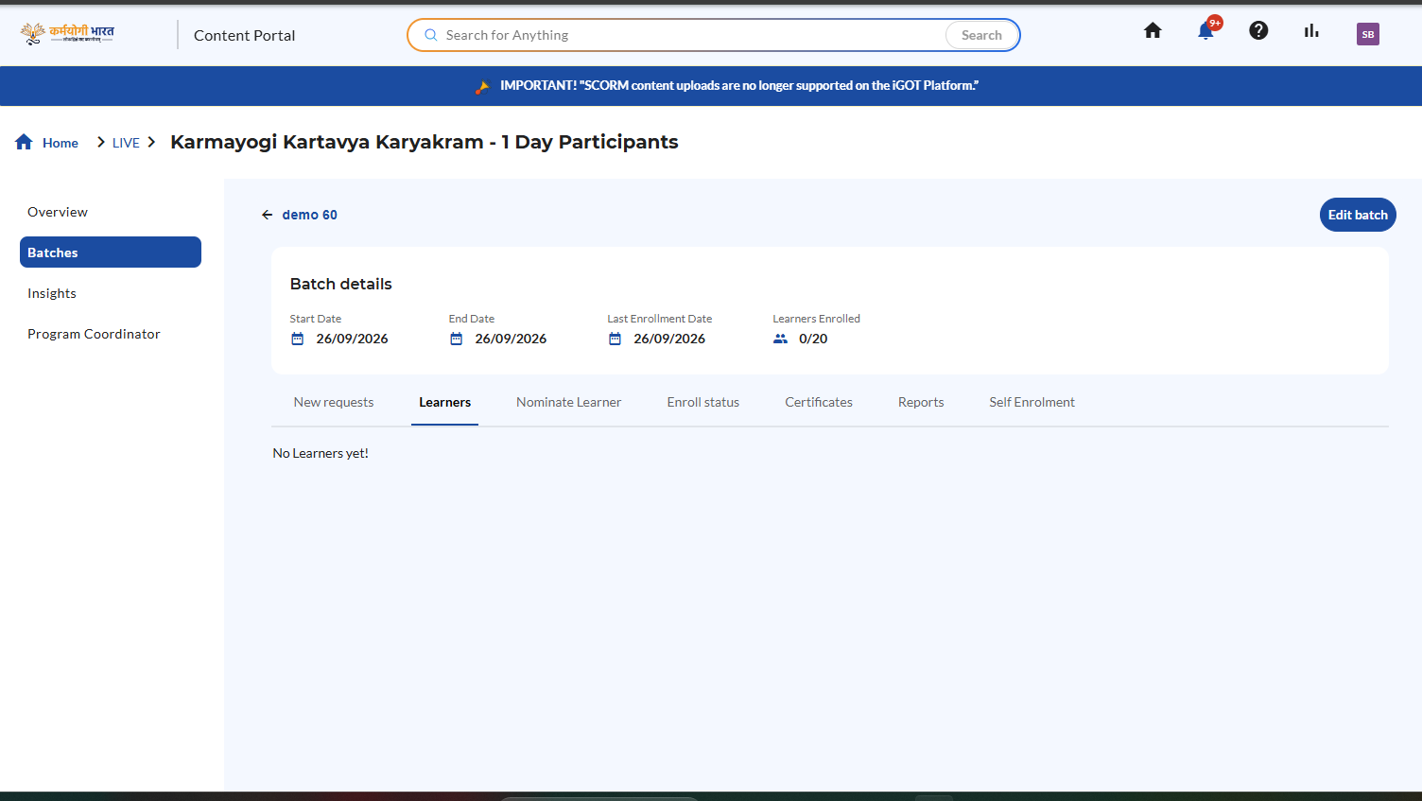


ENROLMENT
Method 3 — Bulk Upload the Participants/Learner
Use the batch’s learner management area to nominate participants.
Role of Trainer
Open the created batch.
Go to the Nominate Learner area.
Download the sample Excel — provide the Phone No. and Email of participants as on iGOT only.
Upload the filled Excel sheet; the learner will be nominated from the trainer’s end.
Role of Participants
Nominated learner searches for “Karmayogi Kartavya Karyakram – 1 Day Participants”.
Click Enrol.
Screen capture from the supplied demo video shows access to Learners, Nominate Learner, Reports and Self Enrolment.

Slide 54




COMPLETION
After Enrolment — Complete the Learning Requirements
Enrolment is not the final programme requirement.
Baseline Survey
Assessment
The baseline survey is conducted on the iGOT application itself.
The assessment is also conducted on the iGOT application.
Certificate access depends on completion of the required programme components.
Participant reminder
Participants should complete the baseline survey and assessment as part of the blended programme requirements.

Slide 55

CHECKLIST
Common Checks Before the Programme Starts
Use this checklist as a final technical verification.
Batch name is unique and identifiable
All mandatory (*) fields are completed
Venue address is correct
Latitude & longitude match the actual venue
Enable QR is selected
Correct batch is opened before generating QR
QR is verified before sharing
QR is shared only on programme day / beginning
Participants know self-enrolment closes at 12 PM
Learner enrolment is confirmed in the batch

Slide 56
SUMMARY
Key Takeaways
Five stages, one accountable workflow for every State Master Trainer.
CREATE
CONFIGURE
GENERATE QR
ENROL
VERIFY
Batch
Location
QR Code
Participants
Completion
Unique name in the standard format
All (*) fields filled
35–40 participants; dates = programme day
Exact venue address with Pincode
Coordinates copied from Google Maps
Wrong coordinates = failed self-enrolment
Keep Enable QR selected
Generate from the correct batch
Verify before sharing
QR scan on iGOT app — primary route
Request Learner if QR fails
Bulk Upload via Nominate Learner
Confirm learners in the batch
Baseline survey & assessment on iGOT
Certificate depends on completion
Timing to remember: Batch in advance • QR shared at the start of the programme day • Self-enrolment closes at 12 PM
Karmayogi Kartavya Karyakram | Technical Session

Slide 57
TECHNICAL SESSION
Karmayogi Kartavya Karyakram
Thank You
Batch Creation • QR Self-Enrolment • Participant Enrolment
Questions & practical walkthrough
Capacity Building Commission
Mission Karmayogi | Government of India
Capacity Building Commission | Karmayogi Kartavya Karyakram

