Slide 1





Regional Workshop
From Training Institutions to Capacity Building Institutions
Vijayawada, AP
September 29 and 30, 2026
1

Slide 2
Day 1
Day 2
Time | Programme Session
09:15-10:00 AM | Registration
10:00-10:05 AM | Lighting of Lamp & Welcoming the Dignitaries & Karmayogi Gaan
10:05-10:10 AM | Welcome Address by Dr. Alka Mittal, Member-Administration, Capacity Building Commission
10:10- 10:13 AM | Address by Shri Peeyush Kumar, Principal Secretary, Planning & Finance, Government of Andhra Pradesh
10:13-10:17 AM | Address by Shri G. Sai Prasad, Chief Secretary, Andhra Pradesh
10:17-10:22 AM | Address by Smt. S. Radha Chauhan, Chairperson, Capacity Building Commission
10:22-10:25 AM | Video on UNNATI
10:25-10:35 AM | State Felicitations
10:35-10:40 AM | Special address by Dr. Jitendra Singh, Minister of State for Ministry of Personnel, Public Grievances and Pensions, Government of India
10:40-10:58 AM | Inaugural address by Shri N. Chandrababu Naidu, Chief Minister, Andhra Pradesh
10:58-11:00 AM | Vote of Thanks
11:00 AM | Group Photograph
11:00-11:15 AM | Tea Break
11:15-01:00 PM | Session 1 - UNNATI Demo, State/UT Presentations and iGOT CBP Demo
01:00-01:30 PM | Session 2 - Karmayogi Quality Framework (KQF) for TIs, and curriculum design for TI
01:30-02:30 PM | Lunch Break
02:30-03:15 PM | Session 3 - Karmayogi Kartavya Karyakram (KKK) Programme
03:15 PM onwards | Session 4 - TI Transformation Consultation, Q&A and Breakout/Group Activity
07:00-09:00 PM | Cultural Programme, Dinner and Networking
Time | Programme Session
10:00-10:15 AM | Shri Peeyush Kumar/ Shri Anant Shankar, Joint Secretary - Planning
10:15-11:00 AM | Session 5 - Expert Session by Shri Krishna Kumar, Founder and CEO, Simplilearn
11:00-12:45 PM | Session 6 - State Action Plan Presentations
 | Wrap-up and Concluding Address
12:45-01:00 PM | Lunch / End of Workshop
2

Slide 3
Inaugural Session
AGENDA COVERAGE
Lighting of Lamp & Welcoming the Dignitaries & Karmayogi Gaan
Welcome Address by Dr. Alka Mittal, Member-Administration, Capacity Building Commission
Address by Shri Peeyush Kumar, Principal Secretary, Planning & Finance, Government of Andhra Pradesh
Address by Shri G. Sai Prasad, Chief Secretary, Andhra Pradesh
Address by Smt. S. Radha Chauhan, Chairperson, Capacity Building Commission
Video on UNNATI
State Felicitations
Special address by Dr. Jitendra Singh, Minister of State for Ministry of Personnel, Public Grievances and Pensions, Government of India
Inaugural address by Shri N. Chandrababu Naidu, Chief Minister, Andhra Pradesh
Vote of Thanks
Group Photograph
2

Slide 4
PLACEHOLDER: Karmayogi Gaan in Telugu

Slide 5

Karmayogi Gaan

Slide 6
Regional Workshop
From Training Institutions to Capacity Building Institutions
Vijayawada, AP
September 29 and 30, 2026
1

Slide 7
State Felicitations

Slide 8

Andhra Pradesh

Slide 9

Karnataka

Slide 10

Odisha

Slide 11
Session 1
Transformation from Training Institute to Capacity Building Institution, anchored through UNNATI

Slide 12


FROM TRAINING INSTITUTIONS
TO CAPACITY BUILDING INSTITUTIONS
Enabling role-based capacity building through Mission Karmayogi
Notes:
Suggested time: 1 minute.
Introduce the session as an institutional transformation conversation. The goal is to connect role-based government capacity requirements with what Training Institutions must be able to do. The session includes demonstrations of CBP creation, demand intelligence and the exchange.
Source: UNNATI_Presentation_AI_Brief(1).md
Supporting source: UNNATI Concept Note, 02.09.26, Sections I–V.

Slide 13
Mission Karmayogi is shifting capacity building from a Rule-Based to Role-Based ecosystem
RULE-BASED
ROLE-BASED
What is my designation / cadre?
What role do I perform?
What rules govern my work?
What functions must I perform?
What training is prescribed?
What competencies does my role require?
One-size fits all training
Capacity building aligned to competencies
As Government capacity building becomes role-based,
Training Institutions must become role-based too.
Notes:
Suggested time: 3 minutes.
Explain that the starting point shifts from designation and prescribed training to the work an official performs and the competencies that work requires. Ask the audience to consider one role they serve. The implication is that institutional programme planning must also become role-based.
Source: UNNATI_Presentation_AI_Brief(1).md
Supporting source: UNNATI Concept Note, 02.09.26, Sections I–V.

Slide 14
Consultations Undertaken for this Transformation
Taskforce-led consultations culminating in the Sadhana Saptah
National Departmental Summit Chaired by Hon’ble MoS (PP)
Policy recommendations for transformation of TIs | 4 month long consultative process
Inputs from States/UTs for Future Ready Governance
1
2
National Workshop with States/UTs was conducted, GAD Secretaries and Sr. Representatives invited
Collaborative Capacity Building
&
Resource Sharing
Post-Excellence Institutional Leadership
&
Mentorship Pathways
States/UTs asked to share inputs on institutionalizing capacity building and enabling performance-linked governance in TIs
3
4
Technology, iGOT
&
AI-Enabled Training Quality Enhancement
Sustainable Funding, Governance
&
Resource Mobilisation
Inputs identified good practices, implementation challenges, & reforms needed to strengthen training institutions and training systems.
150 +
62 +
4
Sr. Officials Consulted
28 States and 8 UTs consulted
TIs Engaged
Policy pathways
Notes:
Suggested time: 2 minutes.
Walk through the journey from Government priorities to roles/functions, CBPs, TI-relevant demand, intervention design, the capability mobilised through UNNATI Exchange, and institutional delivery. Emphasise the intended progression to better competencies, governance and citizen outcomes. Programme delivery insights and learning outcomes should inform subsequent capacity-building planning.
Source: UNNATI_Presentation_AI_Brief(1).md
Supporting source: UNNATI Concept Note, Sections III–V.

Slide 15
A Training Institution becomes a Capacity Building Institution
when it can do three things
01
02
03
Understand Demand
Translate Demand
Deliver Effectively
Understand Government’s
capacity-building demand
Turn relevant demand into
suitable learning interventions
Build or access the capability
required to deliver
What capabilities are required?
For which roles and officials?
What should be taught?
To whom, and through what design?
Faculty, courses and content
Infrastructure and partnerships
From delivering programmes to managing the capacity-building lifecycle
Notes:
Suggested time: 3 minutes.
Present the three institutional capabilities. Understanding demand means knowing required capabilities, roles and officials. Translating demand includes deciding which requirements belong within the TI mandate and designing a suitable intervention. Effective delivery requires the ability to build capability internally or access it through the ecosystem.
Source: UNNATI_Presentation_AI_Brief(1).md
Supporting source: UNNATI Concept Note, 02.09.26, Sections I–V.

Slide 16

Mission Karmayogi enables each step of this journey
01 Understand Demand
02 Translate Demand
03 Deliver Effectively
Capacity Building Plans
on iGOT
Demand Intelligence
Exchange
Feedback
Identify capacity requirements
from roles and competencies.
Identify relevant demand
for each Training Institution.
Access courses, faculty
and infrastructure across TIs.
Demand → Delivery
Notes:
Suggested time: 2 minutes.
Use this as the session anchor. CBPs identify role-based requirements. UNNATI Demand Intelligence determines their relevance to each institution. The TI uses this demand to design interventions. UNNATI Exchange helps it access the faculty, content and facilities needed for delivery.
Source: UNNATI_Presentation_AI_Brief(1).md
Supporting source: UNNATI Concept Note, 02.09.26, Sections I–V.

Slide 17
Capacity Building Plans provide an empirical view
of Government’s capacity requirements
Demand begins with the work officials need to perform
Government /
Department
Priorities
Roles
Functions
performed
Competencies
required
Capacity
Building
Demand
Functional · Behavioural · Domain
From “What courses should we conduct?”
To “What competencies do officials need to perform their roles?”
Notes:
Suggested time: 3 minutes.
Traditional Training Needs Analysis is often periodic, institution-led and intensive. CBPs allow demand to start with Government work: priorities, roles, functions and competencies. Functional, Behavioural and Domain are competency categories. A role requirement is not proof that every role-holder has an assessed gap.
Source: UNNATI_Presentation_AI_Brief(1).md
Supporting source: UNNATI Concept Note, Sections IV–V. UNNATI: From CBPs to training demand, Reference note, Section 1.
CBP updation alrearts to be sent to instiues on quartelt basis: CBP improvement good practices, how to improve upon the CBP creation and updation, what add quality to CBP

Slide 18
How is capacity-building demand empirically identified?
Capacity Building Plan creation
on iGOT Karmayogi
Roles → Functions → Competencies → Capacity-Building Requirements
iGOT Demonstration
Notes:
Suggested time: 5 minutes, including demonstration.
Demonstrate Capacity Building Plan creation on iGOT Karmayogi. Follow one role through its functions and competency requirements. Explain the relevant classification and learning requirements using the live platform. Return to the deck to consider how institutions identify which demand falls within their mandate.
Source: UNNATI_Presentation_AI_Brief(1).md
Supporting source: UNNATI Concept Note, 02.09.26, Sections I–V.

Slide 19
UNNATI converts Government demand into relevant demand
for every Training Institution
A CBP identifies Government need. Each TI responds within its mandate.
Approved mandate and coverage
Capacity Building Plans
What capacity is required?
UNNATI
Demand Intelligence
TI-Specific
Capacity-Building Demand
TI Profile & Mandate
Who and what does the TI serve?
Departments / organisations
Sectors and roles / cadres
Geography and officer groups
Level of application (STO)
Competencies required by
the workforce within
the institution’s mandate
Notes:
Suggested time: 3 minutes.
A CBP identifies Government requirements. The TI profile identifies the workforce and subject remit it serves. Mandate comes first: cadre/service for CTIs, State workforce for ATIs, sector and audience for domain TIs, and the applicable remit for other categories. Approved geography, roles/officer groups and STO conditions refine relevance. Existing courses, faculty and facilities do not gate demand. Unknown conditions need clarification. Matching does not allocate exclusive delivery responsibility. Functional and Behavioural STO comes from the CBP; Domain STO is derived from role/function context and reviewed.
Source: UNNATI_Presentation_AI_Brief(1).md
Supporting source: UNNATI: From CBPs to training demand, Reference note, Sections 1–3.

Slide 20
What competencies does my TI need to build in the workforce?
A live view of relevant capacity-building demand
Competencies required
Relevant roles / cadres
Departments / organisations
Application context
Strategic / Tactical / Operational needs
Potential learning cohorts
Demonstration 1
Notes:
Suggested time: 4 minutes, including demonstration.
Show a TI-specific demand dashboard. Identify the competency, source department, roles/cadres and application context. Distinguish Strategic/Tactical/Operational application from officer seniority or proficiency. Potential learning cohorts remain proposals for review. Do not infer participant numbers or assessed individual gaps from role requirements alone.
Source: UNNATI_Presentation_AI_Brief(1).md
Supporting source: UNNATI: From CBPs to training demand, Reference note, Sections 2–3.

Slide 21

After knowing the demand.
The institution must be able to respond to it.
Capability required
for effective delivery
The right
quality learning
Identified
Capacity-Building
Demand
End-to-end lifecycle based quality system
Quality by design
Rooted in real work context
Aligned to roles
Training Course and Content
Faculty and subject expertise
Infrastructure and facilities
Governance transformation
Digital capability
Build internally
or
Access the wider ecosystem
Notes:
Suggested time: 3 minutes.
The institution chooses an appropriate learning intervention. A course is one option alongside workshops, simulation, field learning and blended programmes. It then identifies content design, expertise, facilities, digital capability and partnership requirements. The institution can develop these capabilities internally or access them through the wider ecosystem.
Source: UNNATI_Presentation_AI_Brief(1).md
Supporting source: UNNATI Concept Note, 02.09.26, Sections I–V.

Slide 22
No Training Institution needs to build everything on its own
Reuse, adapt and collaborate
Access specialised expertise
Share facilities and capacity
Courses & Content
Faculty & SMEs
Infrastructure
UNNATI Exchange
A connected national capacity-building network
Training Institution
Training Institution
Training Institution
Faster response Less duplication Better utilisation Wider reach and quality
Notes:
Suggested time: 3 minutes.
Explain the three shared resource pools: courses/content, faculty/subject matter experts, and infrastructure. Institutions may both contribute to and draw from these pools. The Exchange supports a collaborative network. The expected benefits are faster response, reduced duplication, better utilisation of public capacity, and improved quality and reach.
Source: UNNATI_Presentation_AI_Brief(1).md
Supporting source: UNNATI Concept Note, Sections III and VII.

Slide 23
State Presentations

Slide 24
State/UT Presentations
AGENDA COVERAGE
UNNATI Platform: onboarding, listed resources and resources offered for sharing
KKK: Count of SMTs and SLTs and their saturation against target
iGOT status including frontline workers
Voice of States on UNNATI and KKK, including challenges
OWNER / RR: Pillar Head — Training Institutions and related outreach

Slide 25
State/UT Presentation: Andhra Pradesh
S. No. | Area | Action Items | Status/Remark
1 | UNNATI | Onboarding | 53
 |  | Listed resources | Yes
 |  | Offered and shared resources | In progress
 |  | Total number of departments | 38
 |  | Total number of Departments where CBPs drafted | 35
 |  | Total number of Departments where CBPs are yet to be drafted | 03
2 | KKK | Total State Officials including Frontline Workers to be Covered | 4,12,182
 |  | Master Trainers (MTs) Required (MTs Required: Based on MT capacity of ~100 officials; states may determine numbers as per their implementation plan.) | ~4000
 |  | Karmayogi Kartavya Karyakram Implementation Plan Prepared? (Yes/No) | Yes (In progress)
 |  | Target Timeline for MT & End-Participant Training Completion | December 2027
3 | iGOT | Total Number of State Employees and iGOT onboarding status | 7,89,555
 |  | Frontline official onboarding status on iGOT | ~ 3 Lakhs
 |  | Employees completing at least 1, 2 and 3 courses during FY 2026–27 | 3,39,302
 |  | Total Enrolments and Completion during FY 2026-27 | CE: 2,40,69,981 CC: 1,51,39,972
 |  | Courses uploaded and contributed by the State | 10
 |  | Future Plans on above Indicators | This will be continued as a cascade model to be covered to all departments frontline workers at a large scale

Slide 26
State/UT Presentation: Kerala
S. No. | Area | Action Items | Status/Remark
1 | UNNATI | Onboarding | 9
 |  | Listed resources | In progress
 |  | Offered and shared resources | Yes
 |  | Total number of departments | 48
 |  | Total number of Departments where CBPs drafted | 8
 |  | Total number of Departments where CBPs are yet to be drafted | 40
2 | KKK | Total State Officials including Frontline Workers to be Covered | 2,23,107
 |  | Master Trainers (MTs) Required (MTs Required: Based on MT capacity of ~100 officials; states may determine numbers as per their implementation plan.) | 2,125
 |  | Karmayogi Kartavya Karyakram Implementation Plan Prepared? (Yes/No) | In progress
 |  | Target Timeline for MT & End-Participant Training Completion | December 2027(Subject to Approval)
3 | iGOT | Total Number of State Employees and iGOT onboarding status | 5,25,000 and onboarded 51,298
 |  | Frontline official onboarding status on iGOT | 48,979
 |  | Employees completing at least 1, 2 and 3 courses during FY 2026–27 | 1896
 |  | Total Enrolments and Completion during FY 2026-27 | 13,708 courses and 7,480
 |  | Courses uploaded and contributed by the State | 1 by KILA
 |  | Future Plans on above Indicators | Efforts will be made to onboard all officials in the iGOT and to complete KKK training and UNNATI Training Institutions resources updation

Slide 27
State/UT Presentation: Karnataka
S. No. | Area | Action Items | Status/Remark
1 | UNNATI | Onboarding | 179 TIs onboarded, 26 TIs 80%+, 23 TIs 90%+, 18 TIs 100%
 |  | Listed resources | 456 Faculty, 4 Auditorium, 2 Board Rooms, 5 Classrooms, 4 Computer Labs, 3 Conference Rooms, 3 Dining Facilities, 2 Guest House, 5 Lecture Hall, 3 hostels- 444 capacity, 1 seminar hall, 1 Simulation Lab, 9 Smart Class room, 7 Sports Facility, 4 Trainee Room, 39 domain training courses offered, 20 functional courses offered
 |  | Offered and shared resources | 456 Faculty, 4 Auditorium, 2 Board Rooms, 5 Classrooms, 4 Computer Labs, 3 Conference Rooms, 3 Dining Facilities, 2 Guest House, 5 Lecture Hall, 3 hostels- 444 capacity, 1 seminar hall, 1 Simulation Lab, 9 Smart Class room, 7 Sports Facility, 4 Trainee Room, 39 domain training courses offered, 20 functional courses offered
 |  | Total number of departments | 42
 |  | Total number of Departments where CBPs drafted | 51 (Departments+Organisations)
 |  | Total number of Departments where CBPs are yet to be drafted | 23
2 | KKK | Total State Officials including Frontline Workers to be Covered | 4,00,000
 |  | Master Trainers (MTs) Required (MTs Required: Based on MT capacity of ~100 officials; states may determine numbers as per their implementation plan.) | 4,000
 |  | Karmayogi Kartavya Karyakram Implementation Plan Prepared? (Yes/No) | Draft Submitted to Principal Secretary for the state, DTIs and ATIs have prepared for themselves
 |  | Target Timeline for MT & End-Participant Training Completion | 31st December, 2027

Slide 28
State/UT Presentation: Karnataka
S. No. | Area | Action Items | Status/Remark
3 | iGOT | Total Number of State Employees and iGOT onboarding status | 4,64,019
 |  | Frontline official onboarding status on iGOT | ASHA Workers, Police Constables, etc. are not fully onboarded because they are not listed in HRMS of the state. Meeting held with KB regarding HRMS re-integration to ensure data correction, and creation of MDO Leaders for onboarding frontline workers
 |  | Employees completing at least 1, 2 and 3 courses during FY 2026–27 | Total Data- More than 1- 1,02,456 More than 3- 84,793 More than 5- 56,665
 |  | Total Enrolments and Completion during FY 2026-27 | Enrolments in FY 26-27- 13,91,544 Completion in FY 26-27- 3,91,914
 |  | Courses uploaded and contributed by the State | 25 (Approx)
 |  | Future Plans on above Indicators | Onboard everyone on iGOT Train 4000 MTs and 4,00,000 Officials Ensure Completion of profile of TIs in UNNATI Make CBPs of all the departments and Organisations under them. Generate more courses for iGOT, specifically in Kannada Language

Slide 29
State/UT Presentation: Telangana
S. No. | Area | Action Items | Status/Remark
1 | UNNATI | Onboarding | Yes
 |  | Listed resources | In progress
 |  | Offered and shared resources | In progress
 |  | Total number of departments | 33
 |  | Total number of Departments where CBPs drafted | 10 high- impact sectors: * Department of Agriculture * ⁠Commissionerate of tribal Welfare * ⁠Transport Department * ⁠Department of Health and Family Welfare * ⁠Department of Women Development and Child Welfare * ⁠Horticulture Department * ⁠Panchayati Raj and Rural Development * ⁠School Education Department * ⁠Commissionerate of Technical Education * ⁠Municipal Admin and Urban Development
 |  | Total number of Departments where CBPs are yet to be drafted | 23
2 | KKK | Total State Officials including Frontline Workers to be Covered | 2,93,985
 |  | Master Trainers (MTs) Required (MTs Required: Based on MT capacity of ~100 officials; states may determine numbers as per their implementation plan.) | SLT required- 54 (2 Batches) SMT required- 2800 (80 Batches)
 |  | Karmayogi Kartavya Karyakram Implementation Plan Prepared? (Yes/No) | In progress
 |  | Target Timeline for MT & End-Participant Training Completion | December 2027 (Subject to Approval and resources)

Slide 30
State/UT Presentation: Telangana
S. No. | Area | Action Items | Status/Remark
3 | iGOT | Total Number of State Employees and iGOT onboarding status | 91,311 onboarded
 |  | Frontline official onboarding status on iGOT | To be commenced
 |  | Employees completing at least 1, 2 and 3 courses during FY 2026–27 | 34,843
 |  | Total Enrolments and Completion during FY 2026-27 | Enrolments: 5,09,898 Completion: 3,97,890
 |  | Courses uploaded and contributed by the State | 17 Courses; 5 Courses- Pending Approval
 |  | Future Plans on above Indicators | Efforts are being made to onboard all the employees.

Slide 31
State/UT Presentation: Tamil Nadu
S. No. | Area | Action Items | Status/Remark
1 | UNNATI | Onboarding | 3 State Training Institutes
 |  | Listed resources | Yes
 |  | Offered and shared resources | Yes
 |  | Total number of departments | 48
 |  | Total number of Departments where CBPs drafted | 8
 |  | Total number of Departments where CBPs are yet to be drafted | 40
2 | KKK | Total State Officials including Frontline Workers to be Covered | 4,19,977 (indicative)
 |  | Master Trainers (MTs) Required (MTs Required: Based on MT capacity of ~100 officials; states may determine numbers as per their implementation plan.) | 4000
 |  | Karmayogi Kartavya Karyakram Implementation Plan Prepared? (Yes/No) | In Progress
 |  | Target Timeline for MT & End-Participant Training Completion | December 2027 (Subject to Approval)
3 | iGOT | Total Number of State Employees and iGOT onboarding status | 10 Lakhs employees (approx.) & 3,696
 |  | Frontline official onboarding status on iGOT | 1113
 |  | Employees completing at least 1, 2 and 3 courses during FY 2026–27 | 2745
 |  | Total Enrolments and Completion during FY 2026-27 | 35,499 and 28,777
 |  | Courses uploaded and contributed by the State | Nil
 |  | Future Plans on above Indicators | Ensuring onboarding of maximum state government officials on the iGOT platform

Slide 32
State/UT Presentation: Puducherry
S. No. | Area | Action Items | Status/Remark
1 | UNNATI | Onboarding | 0 (Training Coordinators identified)
 |  | Listed resources | 0 (Training Coordinators identified)
 |  | Offered and shared resources | 0 (Training Coordinators identified)
 |  | Total number of departments | 0
 |  | Total number of Departments where CBPs drafted | 20 (Training given by CBC)
 |  | Total number of Departments where CBPs are yet to be drafted | 37 (Training to be given by CBC)
2 | KKK | Total State Officials including Frontline Workers to be Covered | 22,882
 |  | Master Trainers (MTs) Required (MTs Required: Based on MT capacity of ~100 officials; states may determine numbers as per their implementation plan.) | 223
 |  | Karmayogi Kartavya Karyakram Implementation Plan Prepared? (Yes/No) | No
 |  | Target Timeline for MT & End-Participant Training Completion | 31.12.2027
3 | iGOT | Total Number of State Employees and iGOT onboarding status | 18,045
 |  | Frontline official onboarding status on iGOT | 9371
 |  | Employees completing at least 1, 2 and 3 courses during FY 2026–27 | 13,010
 |  | Total Enrolments and Completion during FY 2026-27 | 0
 |  | Courses uploaded and contributed by the State | 0
 |  | Future Plans on above Indicators | Within the said timeline maximum coverage of staff would be ensured

Slide 33
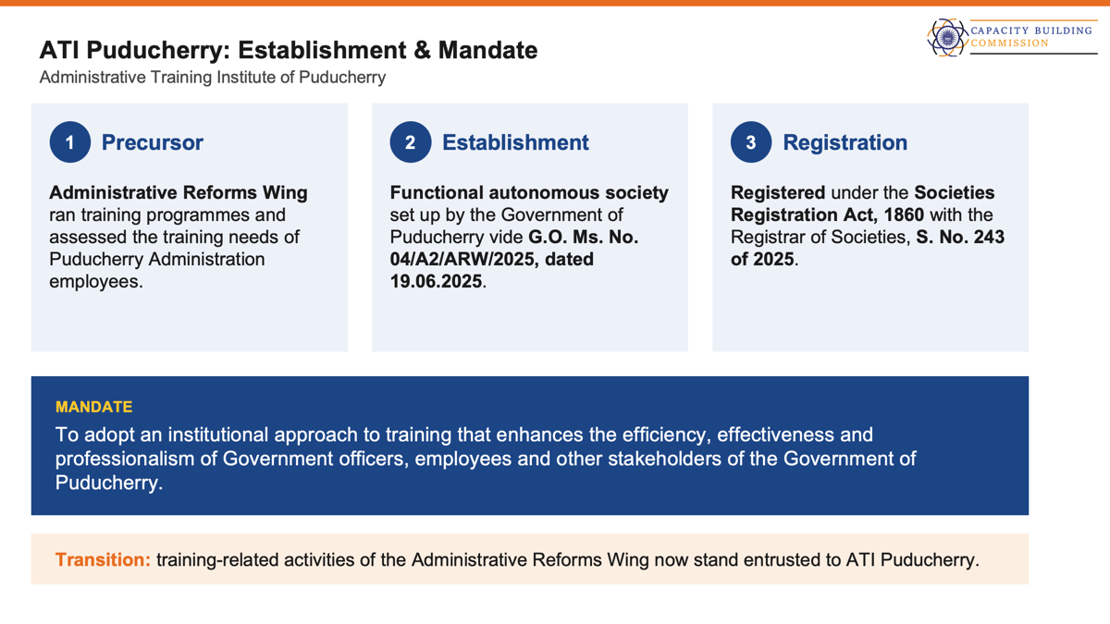

Slide 34
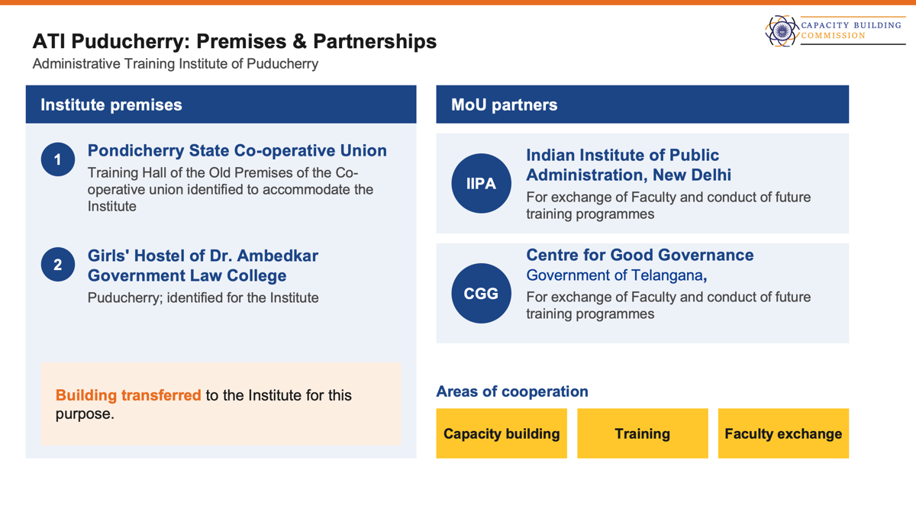

Slide 35
State/UT Presentation: Odisha
S. No. | Area | Action Items | Status/Remark
1 | UNNATI | Onboarding | 21
 |  | Listed resources | Yes
 |  | Offered and shared resources | Resources Shared (Infrastructure, Training Course and Training Faculty)
 |  | Total number of departments | 40
 |  | Total number of Departments where CBPs drafted | 40
 |  | Total number of Departments where CBPs are yet to be drafted | -
2 | KKK | Total State Officials including Frontline Workers to be Covered | 450000
 |  | Master Trainers (MTs) Required (MTs Required: Based on MT capacity of ~100 officials; states may determine numbers as per their implementation plan.) | 3850
 |  | Karmayogi Kartavya Karyakram Implementation Plan Prepared? (Yes/No) | Yes, a tentative plan has been prepared
 |  | Target Timeline for MT & End-Participant Training Completion | 31st March, 2027 and 31st December 2027
3 | iGOT | Total Number of State Employees and iGOT onboarding status | 4,32,846 onboarded as of 27th Sept, 2026
 |  | Frontline official onboarding status on iGOT | 1,43,593 (Teachers, ANMs, PRIs) ASHA, AWW & ULBs yet to be onboarded on iGOT (list shared)
 |  | Employees completing at least 1, 2 and 3 courses during FY 2026–27 | At Least 1 course- 159982, at least 3 course- 142484
 |  | Total Enrolments and Completion during FY 2026-27 | Enrolment- 1891783 Completion: 1880318
 |  | Courses uploaded and contributed by the State | 1.Bharatiya Nagarik Suraksha Sanhita: Dhara 173-193 by Odisha Police 2.Forensic Physical Evidence: Collection and Analysis by State Forensic Science Laboratory, Bhubaneswar
 |  | Future Plans on above Indicators | State Learning Week, Creation of digitized regional language courses through DLL.

Slide 36
Session 2
Karmayogi Quality Framework

Slide 37

KARMAYOGI QUALITY FRAMEWORK
Building Quality
into Learning
KQF
The quality standard
NCDF
Design guidance
QE
Implementation
A
National Curriculum Design Framework
DESIGN / CURATE
B
Quality Evaluator
REVIEW / ASSURE

Slide 38
What is the Karmayogi Quality Framework?
The Karmayogi Quality Framework (KQF) is a unified lifecycle of quality.
Quality lifecycle
Discover
Design
Develop
Deliver
Evaluate
Improve
Key features of KQF
01 | Quality by Design (QbD)
02 | Anchored in work context
03 | Architecture of differentiation
Embedding quality at every stage, with each stage laying the foundation for the next.
Learning starts with the real work and decisions officials face, rather than with content.
Aligns learning with the types and complexity of decisions officials make at strategic, tactical and operational levels.
1
Notes:
The KQF defines a set of standards for developing and delivering content for govt officials. It operates as a lifecycle consisting of 6 stages namely discover, design, develop, deliver, evaluate and improve. The KQF ensures that courses are designed from real work contexts, deliver genuine capability, and produce measurable change in how public officials govern. The KQF is an evolution of the CQF, not a departure from it.

Slide 39
KQF - From Principles to Implementation
One quality framework, two ways of putting it to work
KARMAYOGI QUALITY FRAMEWORK
The quality standard — what good learning must achieve
A
DESIGN / CURATE
B
REVIEW / ASSURE
National Curriculum Design Framework (NCDF)
Quality Evaluator (QE)
A reference architecture and guidance for TIs, SMEs and content creators — what to build, for whom and how to build.
Tools to review, validate and improve learning interventions
Design guidance
Implementation
KQF
is the quality standard
Curriculum
provides design guidance
TQE / CQE
enable implementation
3

Slide 40
What is NCDF?
A reference and a guide
“A structured learning architecture that identifies what capabilities need to be developed, for whom, at what level, and through what sequence of learning experiences.”
Why a curriculum for TIs?
Quality depends on the contextual, relevant and applicable learning experience.
Core principles of NCDF
…enable TIs to move from
1
Competency-based
Training programmes
Learning pathways
2
Role-based
Content coverage
Competency acquisition
3
Learner-centred & contextual
Instruction
Meaningful learning
4
Ethical & values-oriented
Classroom completion
Workplace application
One quality and competency-aligned reference enabling multiple contextualised learning solutions.
4
Notes:
A curriculum provides a structured pathway for building the right capabilities, for the right people, at the right level, through the right learning experiences.
for whom it is taught, What is taught, how it is taught, how learning is assessed,
Why is a curriculum needed - A curriculum gives Training Institutions a clear direction for what to develop, how learning should progress, and how it should connect to real work.

Slide 41
Competency Convergence
Behavioural, functional and domain competencies converge in an actual role and its decisions
Behavioural
How I approach and perform my role
Functional
How I perform the function
NCDF Focus Area
Role- & decision-enabled public service
Domain
What I need to know within my domain (defined by MDOs)
The objective of competency-based learning is to enable the learner to bring these dimensions together in practice.
5

Slide 42
Foundation to Mastery across Decision Complexity
The two complementary dimensions on which the curriculum is built
Competency development ↑
MASTERY
Judging, leading & enabling
Complementary, not sequential
ADVANCED
Integrating & adapting
S-T-O tells us where the competency is applied — the nature and complexity of decisions.
Foundation to Mastery tells us how deeply it has been acquired.
Note: A strategic role does not automatically mean a higher level of competency.
PROFICIENCY
Doing & applying
FOUNDATION
Knowing & recognising
OPERATIONAL
Execution, service delivery, immediate problem-solving
TACTICAL
Translating strategy into programmes and implementation
STRATEGIC
System-level, long-term, high-ambiguity decisions
D e c i s i o n C o m p l e x i t y / Ro l e C o n t e x t →
6
Notes:
The NCDF therefore moves from understanding the public official as a learner, to identifying the competencies they require, differentiating those competencies by role and decision context, and establishing the pedagogical conditions through which those competencies can be developed and applied.

Slide 43
The Architecture Behind the Curriculum
What changes with level
COMPETENCY
01
02
The competency can stay the same.
Complexity of decisions
Work context
03
04
A course designed for one level cannot simply transfer to another without redesign.
Learning outcomes
Learning methods
7
Notes:
How the curriculum can be used by the training institutions to design courses and programmes. Give the example of how the competency can be the same but the approach to teaching is different.

Slide 44
Worked Example: Citizen Centricity Across Levels
COMPETENCY · CITIZEN CENTRICITY
OPERATIONAL
TACTICAL
STRATEGIC
Service delivery
Programme / Service redesign
Citizen-centric policy architecture
Grievance handling
Service Monitoring
Stakeholder leadership
Process Evolution
Institutional mechanisms
Interventions Implementation
“How do I serve this citizen well, right now?”
“How do we make this service work better?”
“What system ensures citizens are served well?”
Same competency. Different work context and decision complexity.
7

Slide 45
From Curriculum to Pedagogy
How a TI turns the national curriculum into its own learning design
The curriculum answers five questions
Pedagogy: how it should be learnt
What capability?
Behavioural & functional competencies
Work-context based
Decision-based
Experiential
For whom?
Learner Persona
Case-based
Reflective
Relational & collaborative
At what level?
Strategic · Tactical · Operational
IKS & Seva Bhav
AI-enabled
Workplace transfer
In what context?
Decision archetype + work context
Complementary, not sequential — one learning experience can combine several.
How is it learnt?
Pedagogy →
9

Slide 46
How to ensure high quality course delivery
National Curriculum
Reference and guide
TI designs a contextualised course
Owned by the TI, built with SMEs
A quality assistant
1
Uses evidence the TI already holds
CBP, calendar, session plans, curriculum, assessments
KQF - QE
Quality Evaluator
2
Flags gaps and suggests improvements
Specific, KQF-aligned recommendations
Review and improvement
TI acts on evidence-based findings
3
The TI reviews and decides
AI proposes, humans decide
Quality learning solution
Ready for delivery
10

Slide 47
The KQF-QE Proposition: How TIs, SMEs and AI Work Together
One quality-by-design System
Training Institute owns the learning solution
Identify
Design
Commission
Integrate
Assure
Improve
TI
SME
SME brings expertise into a defined learning problem
QE
supports
Design brief
SME expertise
Learning solution
TQE / CQE checks evidence, flags gaps, recommends
Discover
Design
Develop
Review
Improve
AI proposes · TI & SME decide
14

Slide 48

Quality Evaluator
CQE demonstration video
17

Slide 49
Session 3
Karmayogi Kartavya Karyakram

Slide 50



Karmayogi Kartavya Karyakram
KARMAYOGI KARTAVYA KARYAKRAM · REGIONAL WORKSHOP
1 / 13
Notes:
Open with energy. Do not explain the programme yet — signal that officers will DO something. Keep this to under 60 seconds.

Slide 51

KARMAYOGI KARTAVYA KARYAKRAM
Let's Create Groups
We will gather you in random groups of 5-6 members for this activity.
GROUP STRUCTURE & COMPOSITION
Member 1
Member 2
Member 3
Member 4
Member 5
KARMAYOGI KARTAVYA KARYAKRAM · REGIONAL WORKSHOP
2 / 13

Slide 52
KARMAYOGI KARTAVYA KARYAKRAM
Think of a Moment
THINK — SILENT — 1 MIN
IT COULD BE A MOMENT WHERE YOU...
Helped someone in real difficulty
Felt genuinely proud of work you did
Rose to a challenge and overcame it
Applied your knowledge to crack a hard problem
Found an innovative solution to a tough issue
Achieved a difficult goal by working with others
Acted with integrity despite real pressure
Made a decision whose impact outlasted your posting
Led a reform through real institutional resistance
Or any other moment that comes to mind
Close your Eyes.. Individually and silently, think of one incident from your work that gave you a deep sense of satisfaction and fulfilment.
Hold that one moment in mind. Remember how you felt
KARMAYOGI KARTAVYA KARYAKRAM · REGIONAL WORKSHOP
Notes:
Give real silence here — 90 seconds to 2 minutes, no talking. This single slide carries the full weight of the story-recall step; do not rush it.

Slide 53
KARMAYOGI KARTAVYA KARYAKRAM
SHARE — 5 MIN
A Moment That Made a Difference
Share the story in following manner:
01
02
03
04
What was the situation?
What did you achieve?
(the visible outcome)
Who benefited from it?
(Yourself, citizens, colleagues, junior, senior, etc.)
What did the experience give you?
Why do you remember this story
Share your story within your group. One member at a time - each member gets 1 min — describe the moment, what you did, and the feeling it gave you.
KARMAYOGI KARTAVYA KARYAKRAM · REGIONAL WORKSHOP
Notes:
THINK (1 min): give a silent moment, do not rush it. SHARE (5 min): groups of 3-4, everyone gets a turn to share their moment briefly.

Slide 54
KARMAYOGI KARTAVYA KARYAKRAM
DISCUSS — 3 MIN
Select Your Story
Step 1: Select one story from your team
Discuss to select any one story shared in part 1 of this exploration.
BASIS FOR SELECTION
Feeling & Personal Fulfillment
Impact & Reach
The feeling of achievement, appreciation, satisfaction, fulfilment etc. experienced in the story.
The impact it made on yourself and others (citizens, colleagues, junior, senior, etc.).
KARMAYOGI KARTAVYA KARYAKRAM · REGIONAL WORKSHOP

Slide 55
KARMAYOGI KARTAVYA KARYAKRAM
CHART PAPER — 4 MIN
Chart the Story
Step 2: Turn that story into your chart
THINK COLLECTIVELY AND FILL IN:
What was the situation ? Write minimum 3 inputs each
Visible Impact
Internal Impact
KARMAYOGI KARTAVYA KARYAKRAM · REGIONAL WORKSHOP
Notes:
CREATE (4 min): groups pick ONE story (most fulfilling + clearest impact), sketch a tree on chart paper, and label Outer Fruit / Inner Fruit / Joy of Contribution together. Circulate and prompt groups that are stuck.

Slide 56

KARMAYOGI KARTAVYA KARYAKRAM · REGIONAL WORKSHOP
7 / 13
Notes:
CREATE (4 min): groups pick ONE story (most fulfilling + clearest impact), sketch a tree on chart paper, and label Outer Fruit / Inner Fruit / Joy of Contribution together. Circulate and prompt groups that are stuck.

Slide 57
KARMAYOGI KARTAVYA KARYAKRAM
Any two or more teams may come and present the chart paper
PRESENTATION FLOW & SUGGESTIONS
Member 1
Shares the story, briefly
Member 2
What was achieved
1
2
Member 3
Visible Impact
Member 4
Invisible Outcome
3
4
Member 5
Special input, then open floor
All Participants
Share any other impact they think the storyteller experienced
5
ALL
KARMAYOGI KARTAVYA KARYAKRAM · REGIONAL WORKSHOP
Notes:
PRESENT (1-2 min): call on 1-2 groups only — do not go around the room. Hold them to 3 minutes. Thank every group even if they don't present.

Slide 58

KARMAYOGI KARTAVYA KARYAKRAM
Special Input
“If you were the beneficiary of the story…”
Think what impact it would have made on you?
KARMAYOGI KARTAVYA KARYAKRAM · REGIONAL WORKSHOP
Notes:
Ask the question aloud, then hold 15–20 seconds of real silence — do not rush to the reveal. This is the first of three individual reflections; set an unhurried pace here since the room will follow it for the next two.

Slide 59
KARMAYOGI KARTAVYA KARYAKRAM
Special Input
“If you were the beneficiary of the story…”
Think what impact it would have made on you?
KARMAYOGI KARTAVYA KARYAKRAM · REGIONAL WORKSHOP
Notes:
Ask the question aloud, then hold 15–20 seconds of real silence — do not rush to the reveal. This is the first of three individual reflections; set an unhurried pace here since the room will follow it for the next two.

Slide 60



KARMAYOGI KARTAVYA KARYAKRAM
Special Inputs
Reflect on the storyteller’s experience of fulfilment.
01 ·
02 ·
03 ·
How often do we experience such moments of fulfilment in our own work?
What would change if we created more such moments in our everyday work?
How might these moments influence the way we work and the impact we create?
KARMAYOGI KARTAVYA KARYAKRAM · REGIONAL WORKSHOP
Notes:
Ask, pause, reveal — same rhythm. This is the last of the three individual reflections before the closing beat.

Slide 61

KARMAYOGI KARTAVYA KARYAKRAM
Discussion
CLASS DISCUSSION
Look at your chart papers carefully.
Did you notice any common outcomes or achievements across the stories shared during the presentation?
Sharing A few participants may share their observations with the room.
KARMAYOGI KARTAVYA KARYAKRAM · REGIONAL WORKSHOP
Notes:
A show of hands only — no need to discuss answers aloud or call on anyone. Keep this brief; it leads straight into the Takeaway slide.

Slide 62

What Did We Just Experience?
~1-2 min
A real experience.
A story.
Its impact.
What it grew within us.
Peer learning.
Reflective learning
THIS IS BEHAVIOURAL REFLECTION IN ACTION.
KARMAYOGI KARTAVYA KARYAKRAM · REGIONAL WORKSHOP

Slide 63
Karmayogi Kartavya Karyakram
KARMAYOGI KARTAVYA KARYAKRAM · REGIONAL WORKSHOP
1 / 13
Notes:
Open with energy. Do not explain the programme yet — signal that officers will DO something. Keep this to under 60 seconds.

Slide 64



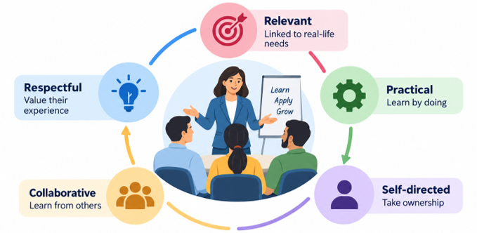
Vision: Why Karmayogi Kartavya Karyakram
VISION
To nurture the culture of Seva Bhav (spirit of service) among public servants by reconnecting their inner purpose with the outer expression of public service.
THE PROGRAMME AIMS TO
Citizen-Centric Service
Responsiveness & Collaboration
Purpose-Driven Service
Vision
RKYP
Programme
Modules
Cascade
Two Tracks
Where It Lives
Rollout
South Cluster
Roles
Our Ask

Slide 65
Where We Began: The Rashtriya Karmayogi Jan Seva Programme
RKYP · MISSION KARMAYOGI
CONCLUDED 10 FEBRUARY 2026
THE NEXT PHASE
A national behavioural training initiative, primarily for Central Government ministries, departments, organisations and institutions.
Demand to continue
Several Ministries and Departments requested continuation of behavioural capacity building.
Impact assessment
Conducted 90 days after the programme: a significant shift in mindset towards Seva Bhav and a more positive approach to work.
Extends Seva Bhav to every public servant, leveraging the trainer ecosystem created under RKYP.
10.5 lakh
officials trained
State
17,000+
Lead & Master Trainers created
Central
85+
Ministries & Departments covered
The program leverages the trainer ecosystem built under RKYP to scale behavioural training across Central and State Governments.
Vision
RKYP
Programme
Modules
Cascade
Two Tracks
Where It Lives
Rollout
South Cluster
Roles
Our Ask

Slide 66
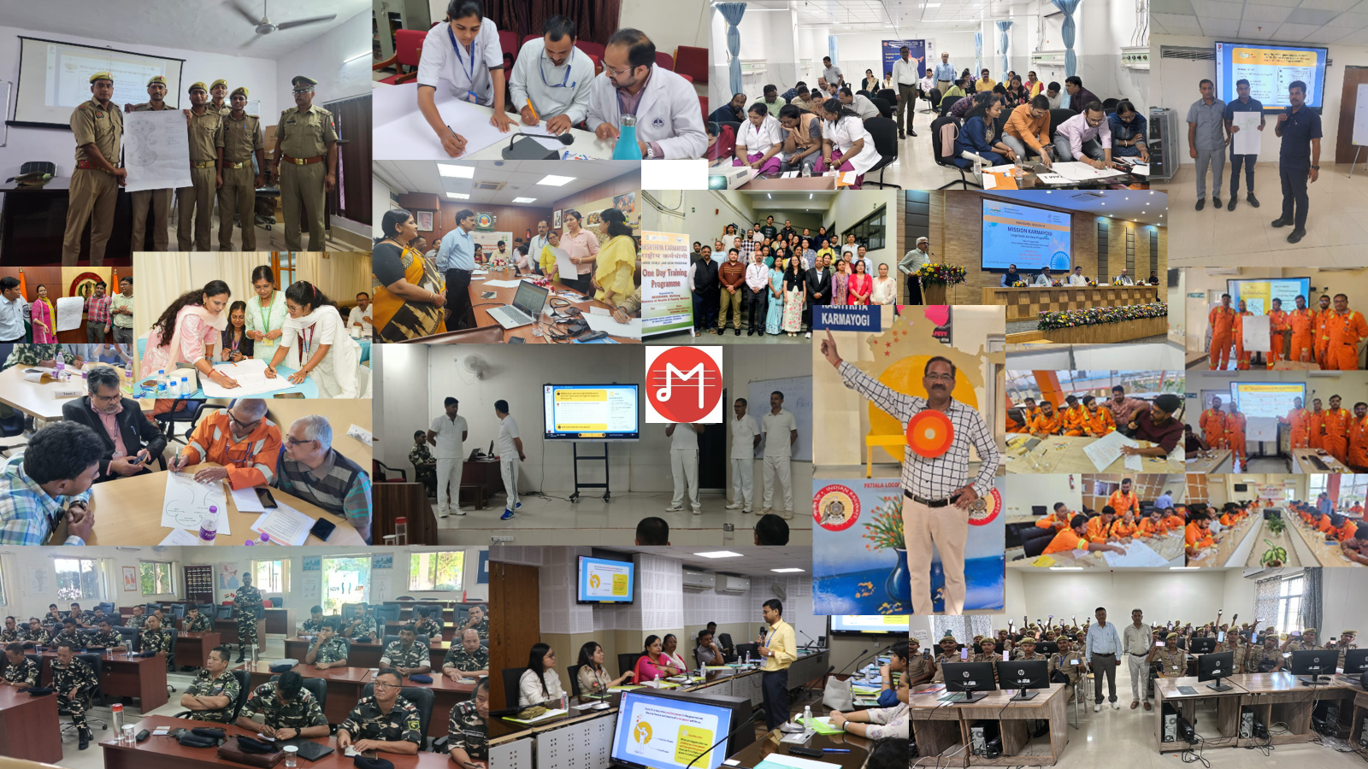

Slide 67
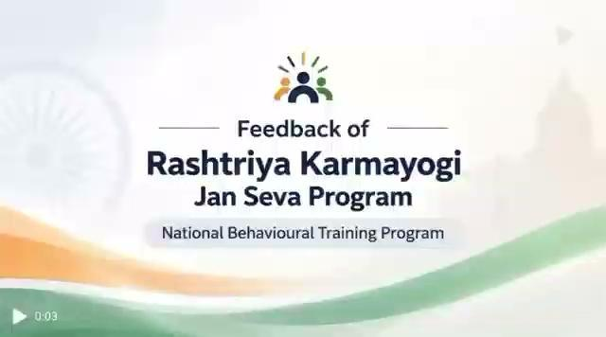
In Their Words: Feedback from RKYP
Feedback video — insert here
(Insert › Video › This Device, resize to fill this frame, then delete this placeholder)
Vision
RKYP
Programme
Modules
Cascade
Two Tracks
Where It Lives
Rollout
South Cluster
Roles
Our Ask
Capacity Building Commission | Government of India | Senior Officers Briefing | South Regional Workshop
05 / 20

Slide 68




What is the Programme?
A BLENDED-LEARNING APPROACH
Behavioural, on-ground training combined with digital learning on iGOT, built on adult learning principles for real behavioural shifts, not just awareness.
Experience-Based Learning
Peer Interaction
Activity-Based Exercises
Reflective Practice
Learning drawn from real-life experience, not lectures.
Collaborative discussion among participants, facilitated not taught.
Hands-on exercises rather than passive listening.
Space to reflect on one's own role in citizen-centric service.
FOUR PROGRAMME COMPONENTS
One-Day Behavioural Training
Master Trainer Programme
Digital Learning (iGOT)
Institutionalisation
4.5 hours · 35–40 per batch
2 days · 35–40 per batch
Self-paced
RKY
All faculty of ATI & DTI shall be trained under the program
Core learning initiative for all target officials
Builds facilitator capacity for cascade delivery
Pre/post reinforcement and a self-learning course
Vision
RKYP
Programme
Modules
Cascade
Two Tracks
Where It Lives
Rollout
South Cluster
Roles
Our Ask

Slide 69
Inside the One-Day Training: The Four Modules
MODULE
PURPOSE
PARTICIPANTS LEAVE ABLE TO…
Who is a Rashtriya Karmayogi?
Builds a shared understanding of the Rashtriya Karmayogi ideal
Share a common understanding of the Rashtriya Karmayogi ideal
1
Expanding Our Vision of Success and Fulfilment
Widens what “success” and “fulfilment” can mean through one's work
See the wider success and fulfilment possible through work, and awaken the intent to serve
2
Creating Karmayogi Moments
A simple, practical technique participants can use immediately
Translate the Karmayogi ideal into everyday work with a simple technique
3
The Rashtriya Karmayogi as a Nation-Builder
Connects the individual's daily role to the larger national mission
Connect their role to ministry objectives, national goals and citizens
4
4.5 hours · each module builds on the last — a journey of self-discovery and application
Vision
RKYP
Programme
Modules
Cascade
Two Tracks
Where It Lives
Rollout
South Cluster
Roles
Our Ask

Slide 70
How to reach frontline officials: Cascade Trainer Model
1
2
3
4
5
National Lead Trainers
Initial SMT Cohort
State Lead Trainers
Expanded SMT Cohorts
Frontline Officials
NLTs
State Master Trainers
SLTs
State Master Trainers
Target participants
WHO
WHO
WHO
WHO
WHO
RKYP trainer pool · 1 pair per ATI
~40 from ATI / DTI faculty (large states: more cohorts)
Auto-certified SMTs
Nominated by departments, ATIs and training institutions
~1 crore nationally: Police, Teachers, Health Workers
ROLE
ROLE
ROLE
ROLE
ROLE
Run the 2-day Master Trainer Programme for the initial SMT cohort
Deliver one-day the program sessions
Train further SMT cohorts through the 2-day programme (in pairs)
Deliver one-day sessions to state officials and frontline workers
Attend the 4.5-hour one-day programme
NOTE
HOW THEY MOVE ON
HOW THEY MOVE ON
HOW THEY MOVE ON
BATCH
Always train in pairs
After 3 one-day batches → auto-certified as SLTs
Anchor expansion of the state trainer ecosystem
Min. 3 batches each ≈ 90–105+ officials
35–40 per batch
Trainer formula: SMTs needed = (Officials ÷ Batch size) ÷ Batches per SMT | Min. 3 batches per SMT ≈ 90–105+ officials | ~1 lakh SMTs needed nationally
Vision
RKYP
Programme
Modules
Cascade
Two Tracks
Where It Lives
Rollout
South Cluster
Roles
Our Ask

Slide 71
How Implementation Works: Central + State Tracks
Departmental institutes onboard existing RKYP trainers, running in parallel across Central MDOs.
ATI is the nodal institution, beginning with the SMT cohort; DTIs / Departments support delivery of the one-day programme.
CENTRAL GOVERNMENT TRACK
STATE GOVERNMENT TRACK
Existing RKYP Trainer Pool
National Lead Trainers (NLTs)
Lead Trainers & Master Trainers already trained and certified
Seed the initial State Master Trainer cohort
↓
↓
One-Day the program
State Master Trainers (SMTs)
For Central Government officials not yet covered under RKYP
~40 per state, drawn from ATI/DTI faculty
↓
↓
Departmental Training Calendars
State Lead Trainers (SLTs)
Integrated into Foundation, Induction, Mid-Career and In-Service programmes
Auto-certified after 3 successful one-day batches
↓
↓
Central / Departmental Rollout
Expansion via ATIs / DTIs / Departments
Sustained through institutions' own existing training systems
Wider trainer ecosystem delivers at scale statewide
↓
Central + State Trainer Pools
→
Trainer Certification
→
One-Day Program
→
Institutionalisation
Vision
RKYP
Programme
Modules
Cascade
Two Tracks
Where It Lives
Rollout
South Cluster
Roles
Our Ask

Slide 72
Where Can the Programme Live in Your Institution?
Foundational Training
Induction Training
Mid- Career Training
Leadership Program
Collective Reflection
Core module for newly recruited personnel
First-week orientation for newly appointed officials
Refresher and advanced behavioural module
A behavioural anchor in senior leadership development
Samuhik Charcha sessions that sustain peer reflection
In-Service / Dept. Training
Periodic one-day sessions in departmental calendars
Specialised / Sectoral
Contextualized delivery in domain academy curricula
Existing Training Calendar + Program Behavioural Component = Institutionalisation. The program builds the capacity of the faculty of ATI/DTI .
Vision
RKYP
Programme
Modules
Cascade
Two Tracks
Where It Lives
Rollout
South Cluster
Roles
Our Ask

Slide 73
National rollout: four phases to universal State coverage by December 2028
Phase 1
Phase 2
Phase 3
Phase 4
Apr – Sep 2026
Oct 2026 – Mar 2027
By Dec 2027
By Dec 2028
SMT training by NLTs begins; initial rollout of one-day the program
Trainer networks expand; SLTs auto-certified from SMTs; SLTs train further SMTs
Priority frontline sectors covered: Teachers, Health Workers, Police
Universal coverage of State Government officials; the program institutionalised in state training systems
TARGET · PHASE 1–3, BY DECEMBER 2027
WHERE WE ARE
~1.3 crore
~1 crore
State frontline officials (Police, Teachers, Health Workers)
+ ~30 lakh
Central officials not covered under RKYP
20
States / UTs onboarded
1,300+
State Master Trainers trained
~1 lakh trainers across the cascade · ~3 lakh training batches · Universal State coverage by 2028
~5,000
one-day participants trained
Vision
RKYP
Programme
Modules
Cascade
Two Tracks
Where It Lives
Rollout
South Cluster
Roles
Our Ask

Slide 74
In South Cluster: 22.5 Lakh Target
 | TARGET |  |  |  |  | CURRENT STATUS
State / UT | Frontline officials |  | SMTs needed | SMT batches | ≈ Batches / month | SMTs trained | SLTs certified | One-day participants
Odisha | 4,47,573 |  | 3,730 | 107 | 22 | 87 | 2 | 30
Karnataka | 4,42,466 |  | 4,214 | 121 | 25 | 100 | 0 | 350
Tamil Nadu | 4,19,977 |  | 4,000 | 120 | 23 | 0 | 0 | 0
Andhra Pradesh | 4,12,182 |  | 3,926 | 113 | 23 | 28 | 0 | 280
Telangana | 2,93,985 |  | 2,800 | 80 | 16 | 0 | 0 | 0
Kerala | 2,23,107 |  | 2,125 | 61 | 13 | 32 | 0 | 0
Puducherry | 9,371 |  | 90 | 3 | 1 | 0 | 0 | 0
South Cluster | 22,48,661 |  | 20,885 | 600 | 123 | 249 | 2 | 660
Estimates cover frontline workers only; State Government officials will also be covered under the programme.
Vision
RKYP
Programme
Modules
Cascade
Two Tracks
Where It Lives
Rollout
South Cluster
Roles
Our Ask

Slide 75

Feedback of Program : South Cluster
Feedback video — insert here
(Insert › Video › This Device, resize to fill this frame, then delete this placeholder)
Vision
RKYP
Programme
Modules
Cascade
Two Tracks
Where It Lives
Rollout
South Cluster
Roles
Our Ask
Capacity Building Commission | Government of India | Senior Officers Briefing | South Regional Workshop
14 / 20

Slide 76
In South Cluster today
SMTs trained against each State/UT's own SMT requirement
249
Each bar = 100% of that State/UT's requirement. Filled portion = SMTs trained so far.
State Master Trainers trained
Odisha
87 of 3,730
of 20,885 needed across the cluster
Karnataka
102 of 4,214
2
Tamil Nadu
0 of 4,000
State Lead Trainers certified
Andhra Pradesh
28 of 3,926
the first step of the in-state cascade
Telangana
0 of 2,800
233
Kerala
32 of 2,125
one-day participants
trained in one-day sessions so far
Puducherry
0 of 90
Source-table order, not ranked. One colour only: the chart shows where each State/UT is starting from, not performance.
Vision
RKYP
Programme
Modules
Cascade
Two Tracks
Where It Lives
Rollout
South Cluster
Roles
Our Ask

Slide 77
Roles and Responsibility
Institution
Role
What This Looks Like
State ATI / Training Institution
Nodal · Coordinate · Build Trainer Ecosystem
Nominate SMTs from faculty → Host the 2-day Master Trainer Programme → Coordinate rollout and sustain the trainer pipeline
General Administration Department
Coordinate · Direct · Monitor
Coordinate departments for implementation with the ATI → Direct departments to participate and nominate → Monitor progress and timelines
Central Training Institute
Leverage · Integrate · Deliver
Leverage existing RKYP trainer capacity → Integrate the program into Foundation, Induction and Mid-Career programmes
Departmental Training Institute
Contextualise · Deliver · Reinforce
Adapt the message to sector context (policing, health, forests, security, revenue) → Embed it in in-service training calendars
State Master Trainers
Facilitate · Cascade · Mentor
Facilitate one-day sessions → Cascade the trainer pipeline → Mentor emerging trainers
Vision
RKYP
Programme
Modules
Cascade
Two Tracks
Where It Lives
Rollout
South Cluster
Roles
Our Ask

Slide 78
What we need from you next
1
2
3
4
5
PLAN
BUILD TRAINER CAPACITY
CREATE THE SLT PIPELINE
DELIVER ON iGOT
EMBED IN EXISTING SYSTEMS
GAD & ATI
ATIs & DTIs
ATIs & SMTs
All implementing institutions
ATIs, DTIs & CTIs
Prepare a State/UT implementation plan
Train all your faculty as State Master Trainers
Build a cohort of State/UT Lead Trainers
Conduct the programme on the iGOT Karmayogi platform
Build program into foundation, induction, mid-career and in-service calendars
Based on target one-day participants: State Government officials and frontline workers
Conduct additional SMT batches in the ATIs
SMTs who complete 3 batches become SLTs, who can cascade and conduct SMT batches
Onboarding, training records, certification and monitoring on one platform
Samuhik Charcha ~6 months after training sustains the learning
This program not only strengthens not only behavioural competencies but also the delivery capabilities of faculty at ATIs/DTIs, enabling them to effectively facilitate and cascade learning to civil service personnel.
Vision
RKYP
Programme
Modules
Cascade
Two Tracks
Where It Lives
Rollout
South Cluster
Roles
Our Ask

Slide 79
Faculty Development Program
For faculty capacity development we have a dedicated program.
The Capacity Building Commission strengthens state capacity by empowering Civil Service Training Institutions' faculty through the Faculty Development Program (FDP).
The FDP combines an online self-paced module with a 5-day intensive in-person program in collaboration with Indian School of Business.
2800+
Completions
of online self-paced FDP program on iGOT
600
Faculty Target
Training over the next 3 years through a 5-day in-person program
357
Trained Till Date
Successfully completed across 10 batches

Slide 80
South Cluster : FDP Current Status
Current Status
Ministry/State | Organisation Name | Participation (Batch 1-11) | Nominations (Batch 12-14)
Andhra Pradesh | Andhra Pradesh Human Resource Development Institute (APHRDI) | 0 | 0
Karnataka | Administrative Training Institute (ATI), Mysore, Karnataka | 0 | 0
Kerala | Institute of Management in Government (IMG), Kerala | 0 | 0
Odisha | Gopabandhu Academy of Administration (GAA), Odisha | 1 | 0
Tamil Nadu | Anna Administrative Staff College (AASC), Tamil Nadu | 0 | 0
Telangana | Dr. MCR HRD Institute of Telangana (MCRHRDIT) | 2 | 1
FUTURE BATCHES
BATCH CALENDAR — Advanced FDP 2025–27
Quarter / Status | Batch | Programme End | Location
Q4 2026-27 | Batch 20 | 22nd January 2027 | ISB Hyderabad
Q4 2026-27 | Batch 16 | 5th Feb 2027 | ISB Mohali
Q4 2026-27 | Batch 17 | 12th February 2027 | ISB Mohali
Q4 2026-27 | Batch 18 | 5th March 2027 | ISB Mohali

Slide 81
Karmayogi Kartavya Karyakram
Sādhana Shrinkhala
SEVA BHAV
Capacity Building Commission · Government of India
Over to the technical session — 15 minutes

Slide 82
TECHNICAL SESSION
Karmayogi Kartavya Karyakram
STATE MASTER TRAINER WORKSHOP
Batch Creation & Participant Enrolment on iGOT Karmayogi
Create
Configure
Generate QR
Enrol
Verify
Capacity Building Commission
Mission Karmayogi | Government of India
Capacity Building Commission | Technical Session

Slide 83
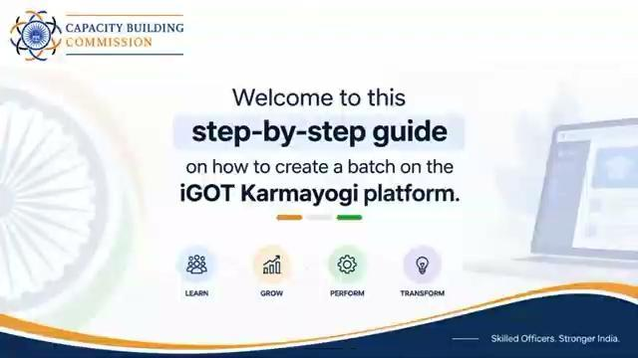

Slide 84





SESSION
Session Outcomes
By the end of the session, participants should be able to perform the complete operational workflow.
01
02
03
04
05
Create a Batch
Configure Location
Enable Self-Enrolment
Enrol Participants
Ensure Baseline Survey & Assessment
Navigate to the Content Portal, open the programme and create a batch with all mandatory fields.
Identify the correct venue coordinates using Google Maps and record them accurately.
Keep Enable QR selected, generate the self-enrolment QR and understand geo-fencing.
Use QR self-enrolment and understand nomination/request-based enrolment workflows.
Confirm learners from the batch and ensure baseline survey and assessment are completed.
Session focus: practical execution, common checks, and facilitator responsibilities.
Karmayogi Kartavya Karyakram | Technical Session

Slide 85

ROLES
State Master Trainer: Two Core Responsibilities
The technical session is built around two operational tasks.
TASK 1
TASK 2
Batch Creation
Participant Enrolment
Create the programme batch, enter the mandatory details, configure the venue location and keep Enable QR selected.
Enable participants to join the batch and manage enrolment through the available workflows.
OPERATIONAL SEQUENCE
Create Batch
Verify Venue
Generate QR
Enrol Participants
Verify Learners
Key principle
Batch configuration and participant enrolment are linked through the batch location and QR settings.
Karmayogi Kartavya Karyakram | Technical Session

Slide 86
WORKFLOW
End-to-End Technical Workflow
Use this as the live-session roadmap.
1
2
3
4
Login to iGOT
Manage Your Program
Create Batch
Configure
Open Content Portal
Open Karmayogi Kartavya Karyakram
Actions › Create Batch
Mandatory details + location + Enable QR
5
6
7
8
Add Batch
Self Enrolment
QR
Participants
Review › Add batch
Open batch › Self Enrolment
Generate › Download › Share on programme day
Enrol › Scan QR › Baseline › Assessment
Steps 1–4 Batch creation Steps 5–8 Enrolment & QR

Slide 87





BATCH CREATION
Batch Creation — Rules to Get Right
These checks prevent duplicate batches, incorrect geo-fencing and failed self-enrolment.
Unique Batch Name
Mandatory Fields
Enable QR
Use a unique {SMT’s Name_[State Name]_[District]_[Venue]_[Date of the Program (dd.mm.yyyy)]}. Avoid duplicate or ambiguous names.
Every field marked (*) must be completed before the batch can be added.
Keep “Enable QR” selected to allow participant self-enrolment through the QR code.
Venue Coordinates
Timing
12 PM Cut-off
Enter the actual programme venue address plus accurate latitude and longitude.
The batch can be created in advance; the QR is shared only on the day of the programme.
Self-enrolment is only possible until 12 PM on the day of the programme.
Remember: the QR is location-tagged. Participants can enrol only when they are physically present at the latitude and longitude recorded for the batch.

Slide 88



ENROLMENT
Participant Enrolment — Three Operational Methods
Use the method applicable to the batch and participant workflow.
METHOD 1
METHOD 2
METHOD 3
QR Scan / Self-Enrolment
Request Learner
Bulk Upload / Nominate Learner
Participant opens the iGOT app, opens the programme, selects Enrol, allows camera access and scans the facilitator’s QR.
The learner submits a request to join; the trainer reviews and approves the request.
Trainer accesses the Learner/Nominate Learner workflow; the participant then completes the enrolment action.
Facilitator responsibility
Know which enrolment method is being used and verify successful enrolment from the batch.

Slide 89
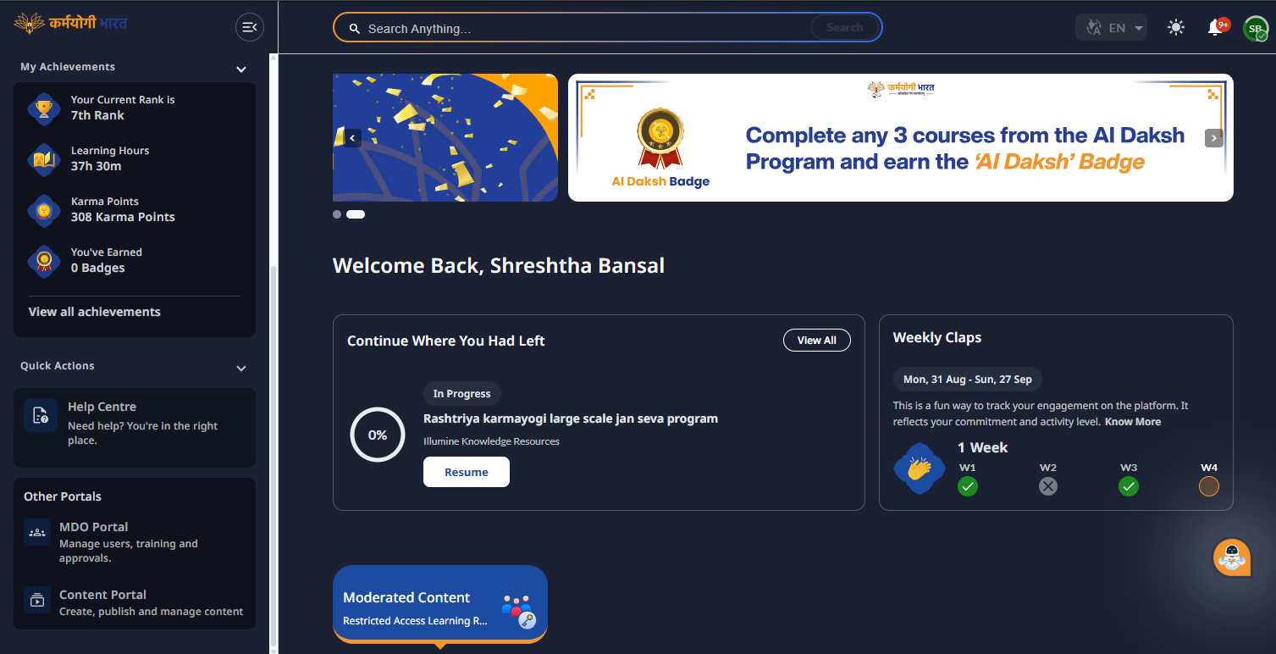

NAVIGATION
Access the Batch Creation Area
Follow the same navigation shown in the screen recording.
1
Log in
Access iGOT on your laptop.
2
Open Content Portal
From the dashboard, select Content Portal.
3
Manage Your Program
Open “Manage Your Program” to reach the programme management area.
The Content Portal is listed under “Other Portals” on the dashboard.

Slide 90
NAVIGATION
Access the Batch Creation Area
Follow the same navigation shown in the screen recording.
1
Log in
Access iGOT on your laptop.
2
Open Content Portal
From the dashboard, select Content Portal.
3
Manage Your Program
Open “Manage Your Program” to reach the programme management area.

Slide 91
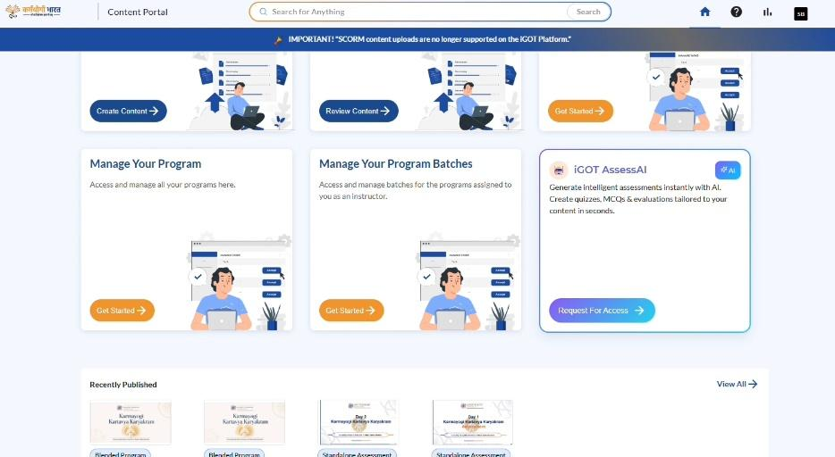
NAVIGATION
Access the Batch Creation Area
Follow the same navigation shown in the screen recording.
1
Log in
Access iGOT on your laptop.
2
Open Content Portal
From the dashboard, select Content Portal.
3
Manage Your Program
Open “Manage Your Program” to reach the programme management area.

Slide 92
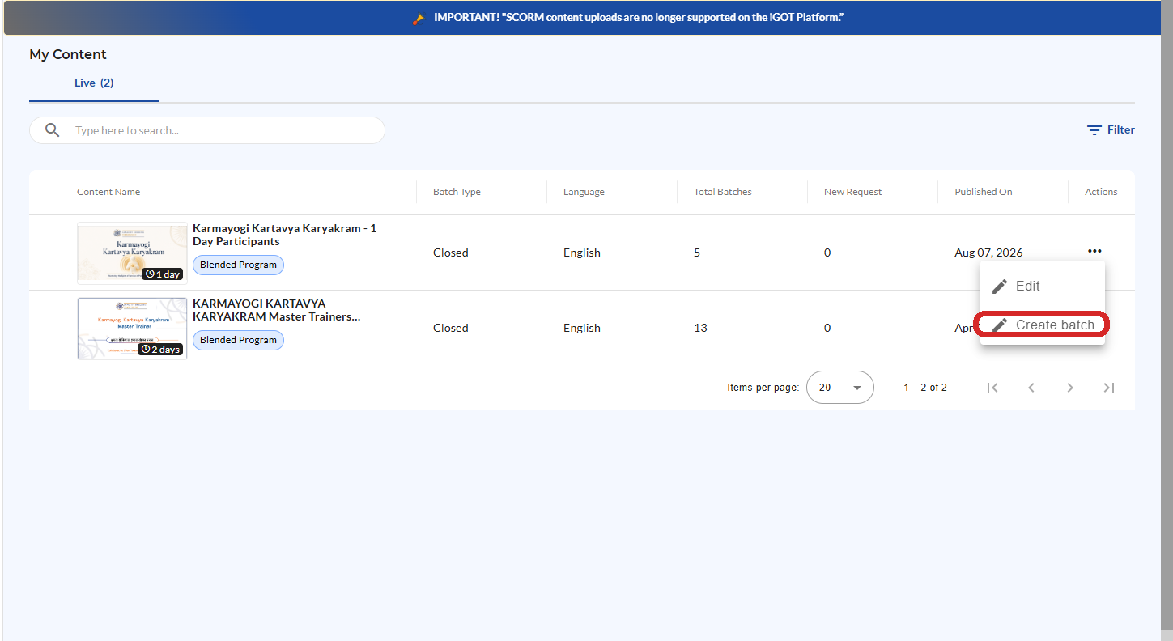

BATCH CREATION
Select the Programme and Create the Batch
Open the programme and use the Actions menu to start batch creation.
1
Open “My Content”.
2
Locate “Karmayogi Kartavya Karyakram – 1 Day Participants”.
3
Open the Actions menu (⋯).
4
Select “Create batch”.
Advance creation
The technical guide notes that the batch can be created 3–4 days before the programme; the QR remains location-tagged.

Slide 93
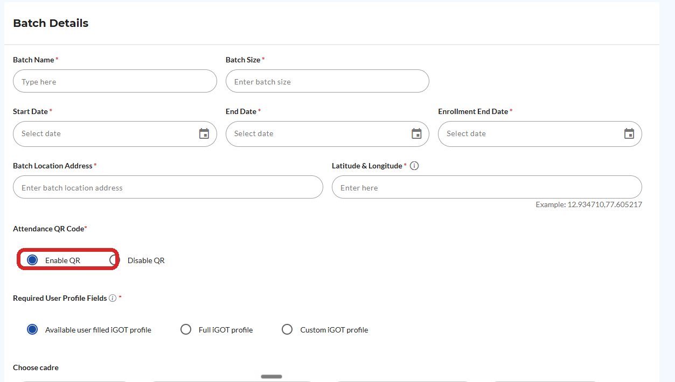

BATCH DETAILS
Complete the Mandatory Batch Details
Enter the fields carefully; the location fields are critical for geo-fencing.
Field | What to enter
Batch Name | {SMT’s Name_[State Name]_[District]_[Venue]_[Date of the Program (dd.mm.yyyy)]}
Batch Size | Planned capacity — recommended 35 to 40 participants only
Start / End Date | Programme dates — same date of the programme
Enrolment End Date | Closing date — same date of the programme
Batch Location Address | Actual venue — full address with Pincode
Latitude & Longitude | Venue coordinates
Attendance QR Code | Keep “Enable QR” selected
Required User Profile Fields | “Available user filled iGOT profile” unless the programme requires another option
Critical check
If Enable QR is not selected, participants cannot self-enrol by scanning the QR code.

Slide 94
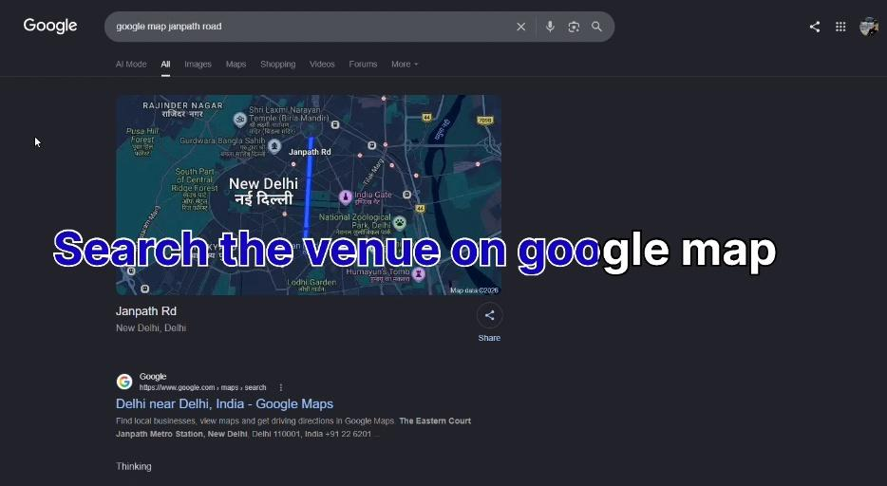
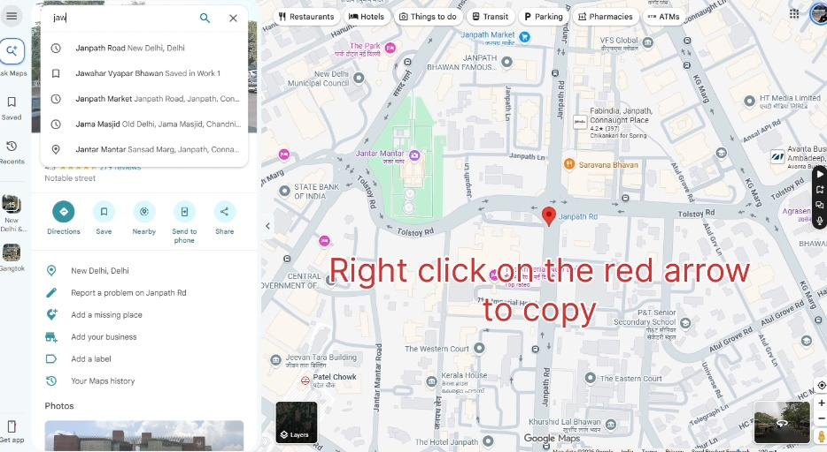
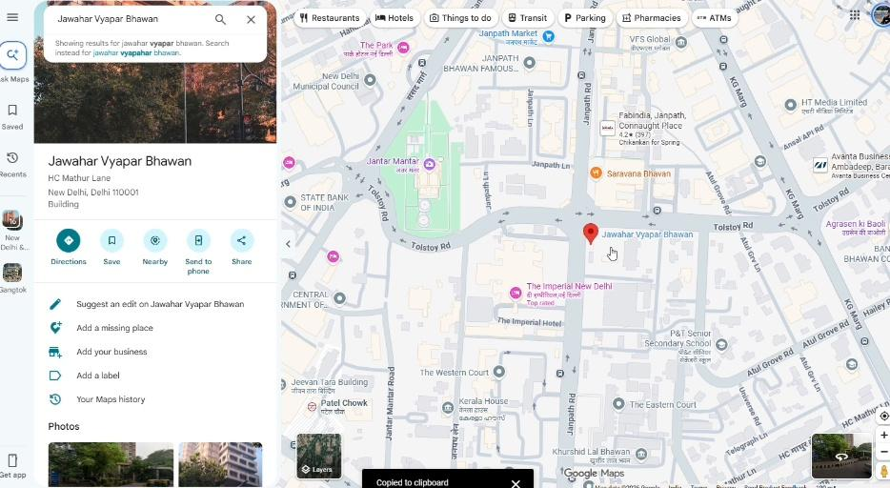
LOCATION
How to Get Latitude & Longitude from Google Maps
Use the exact programme venue — not a nearby landmark or general locality.
1
Search the venue
2
Locate the exact venue
3
Copy the coordinates
GOOGLE MAPS SEQUENCE
Open Google Maps
Search / locate the venue
Right-click the exact location
Read the decimal coordinates at the top
Left-click the coordinates to copy
Paste into Latitude & Longitude

Slide 95


LOCATION
Location Accuracy Is a Technical Control
The coordinates recorded during batch creation determine where QR self-enrolment can occur.
Before clicking Add Batch
Confirm that the address and coordinates correspond to the actual programme venue.
Why it matters
The self-enrolment QR is location-tagged and checks the participant’s physical location.
If coordinates are wrong
Participants may be unable to self-enrol at the intended venue.

Slide 96
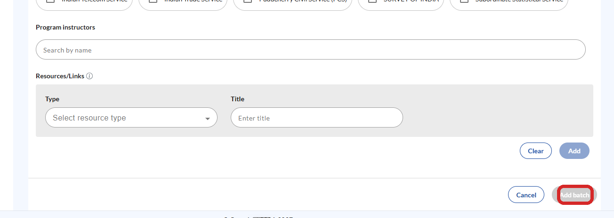
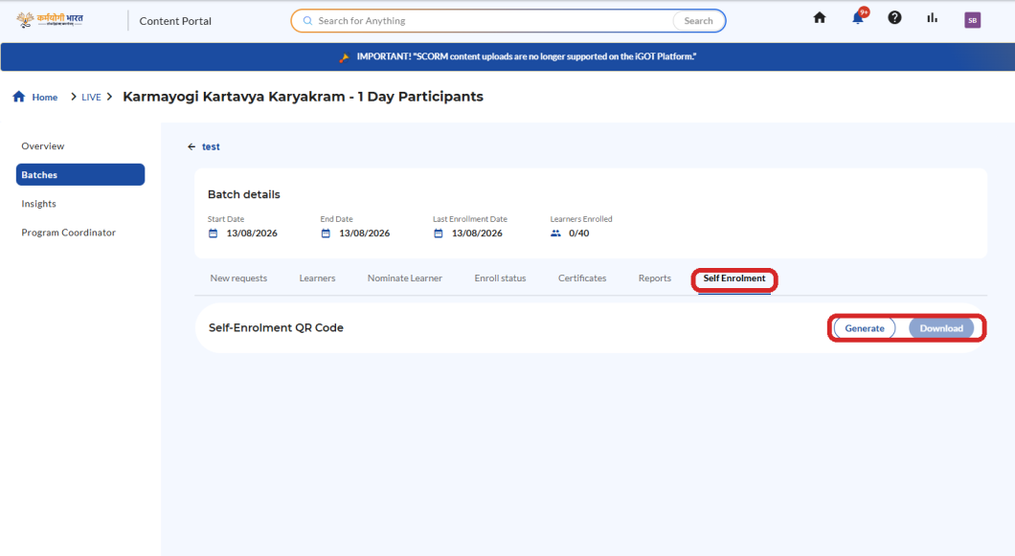

BATCH CREATION
Add the Batch and Open Self Enrolment
Complete the form, create the batch, then move to the Self Enrolment tab.
1
Scroll to the bottom of the form.
2
Select “Add batch”.
3
Optional fields such as Program Instructors and Resources/Links can remain blank unless required.
Operational check
After creation, verify that the correct batch is open before generating the QR.
4
Open the newly created batch.
5
Select the “Self Enrolment” tab.

Slide 97
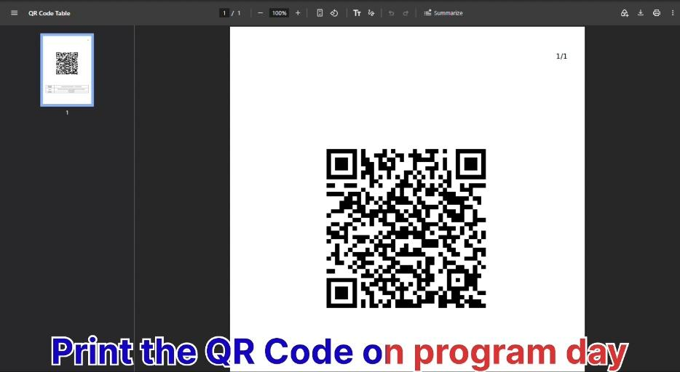



QR CODE
Generate, Download and Share the QR Code
The QR is the bridge between the facilitator’s batch and participant self-enrolment.
Open Self Enrolment
Select Generate, then Download
Verify that the correct QR is being shared

Slide 98



QR CODE
QR Code: Timing, Geo-Fencing & Participant Access
Three rules should be communicated clearly to every facilitator.
WHEN
WHERE
UNTIL WHEN
Share the Self-Enrolment QR only on the day of the programme, at the beginning of the programme.
Participants must be physically present at the latitude and longitude associated with the batch.
Self-enrolment is possible only until 12 PM on the day of the programme.
Do not share an unverified or incorrect QR code.
Before the session starts
Verify the QR, confirm the batch location details, and ensure the facilitator is using the QR generated for the correct batch.

Slide 99


SECTION 2
Participants Enrolment
KARMAYOGI KARTAVYA KARYAKRAM
Three ways to bring participants into the batch
Method 1 QR Scan / Self-Enrolment
Method 2 Request Learner
Method 3 Bulk Upload the Participants/Learner
Capacity Building Commission
Mission Karmayogi | Government of India

Slide 100
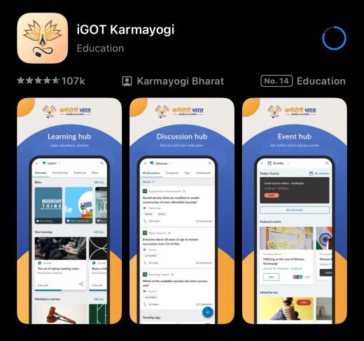
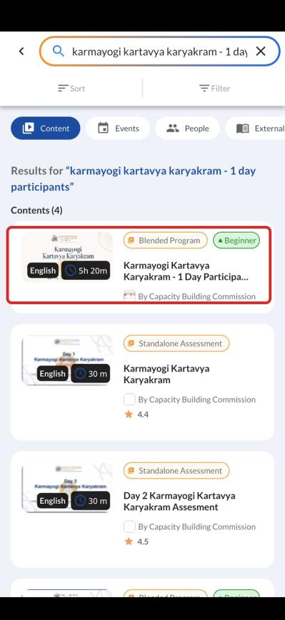
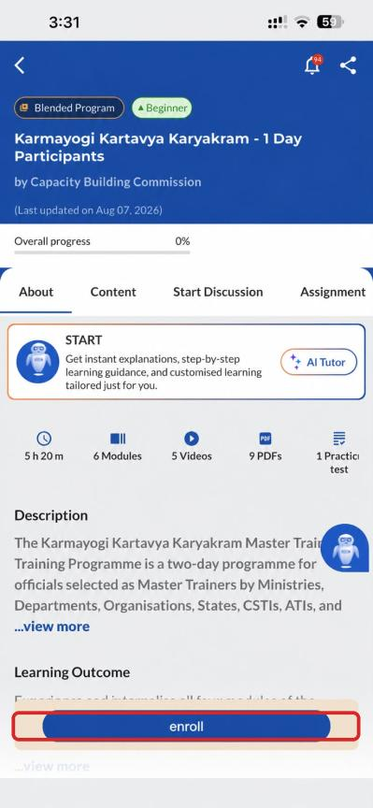

ENROLMENT
Method 1 — QR Scan / Self-Enrolment
Participant workflow on the iGOT mobile application.
1
Open the iGOT app
Sign in on the participant’s mobile device.
2
Find the programme
Search for “Karmayogi Kartavya Karyakram – 1 Day Participants”.
Important
The QR scan should be performed from the iGOT application.
3
Enrol & scan
Select Enrol, allow camera access if prompted, and scan the QR shared by the facilitator.

Slide 101

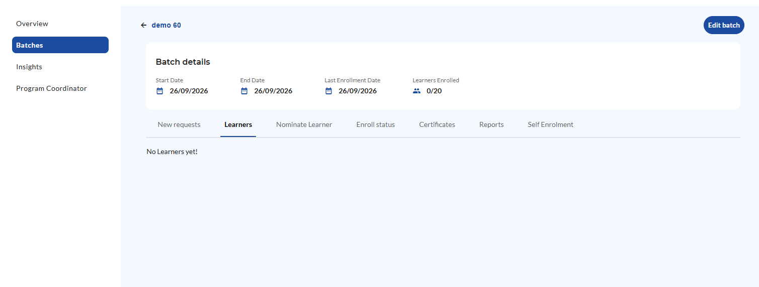
ENROLMENT
Method 2 — Request Learner
Learner-initiated enrolment with trainer approval.
Why use this method? If the QR Code isn't functional this method could be utilised.
1
Learner requests
2
Trainer reviews
3
Approve
The learner submits a request to join the relevant batch.
The trainer checks the New request in the batch management area.
The trainer approves the request and the learner can proceed with the programme.

Slide 102
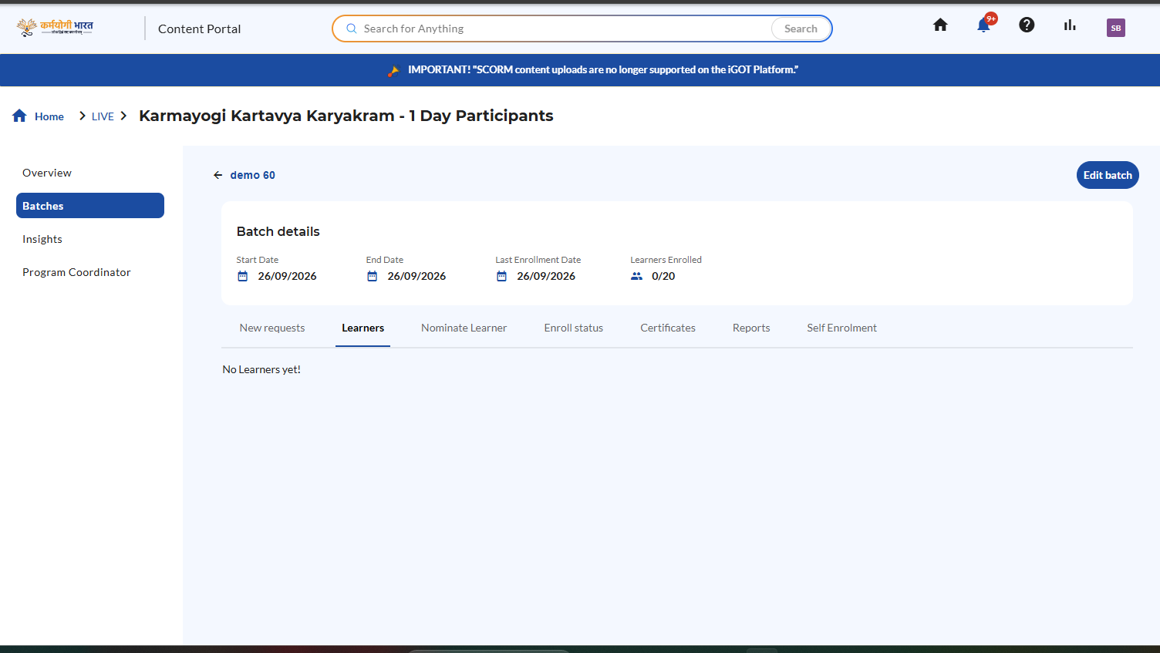


ENROLMENT
Method 3 — Bulk Upload the Participants/Learner
Use the batch’s learner management area to nominate participants.
Role of Trainer
Open the created batch.
Go to the Nominate Learner area.
Download the sample Excel — provide the Phone No. and Email of participants as on iGOT only.
Upload the filled Excel sheet; the learner will be nominated from the trainer’s end.
Role of Participants
Nominated learner searches for “Karmayogi Kartavya Karyakram – 1 Day Participants”.
Click Enrol.
Screen capture from the supplied demo video shows access to Learners, Nominate Learner, Reports and Self Enrolment.

Slide 103




COMPLETION
After Enrolment — Complete the Learning Requirements
Enrolment is not the final programme requirement.
Baseline Survey
Assessment
The baseline survey is conducted on the iGOT application itself.
The assessment is also conducted on the iGOT application.
Certificate access depends on completion of the required programme components.
Participant reminder
Participants should complete the baseline survey and assessment as part of the blended programme requirements.

Slide 104

CHECKLIST
Common Checks Before the Programme Starts
Use this checklist as a final technical verification.
Batch name is unique and identifiable
All mandatory (*) fields are completed
Venue address is correct
Latitude & longitude match the actual venue
Enable QR is selected
Correct batch is opened before generating QR
QR is verified before sharing
QR is shared only on programme day / beginning
Participants know self-enrolment closes at 12 PM
Learner enrolment is confirmed in the batch

Slide 105
SUMMARY
Key Takeaways
Five stages, one accountable workflow for every State Master Trainer.
CREATE
CONFIGURE
GENERATE QR
ENROL
VERIFY
Batch
Location
QR Code
Participants
Completion
Unique name in the standard format
All (*) fields filled
35–40 participants; dates = programme day
Exact venue address with Pincode
Coordinates copied from Google Maps
Wrong coordinates = failed self-enrolment
Keep Enable QR selected
Generate from the correct batch
Verify before sharing
QR scan on iGOT app — primary route
Request Learner if QR fails
Bulk Upload via Nominate Learner
Confirm learners in the batch
Baseline survey & assessment on iGOT
Certificate depends on completion
Timing to remember: Batch in advance • QR shared at the start of the programme day • Self-enrolment closes at 12 PM
Karmayogi Kartavya Karyakram | Technical Session

Slide 106
TECHNICAL SESSION
Karmayogi Kartavya Karyakram
Thank You
Batch Creation • QR Self-Enrolment • Participant Enrolment
Questions & practical walkthrough
Capacity Building Commission
Mission Karmayogi | Government of India
Capacity Building Commission | Karmayogi Kartavya Karyakram

Slide 107
Session 4
TI Transformation: Consultation, Q&A & State-wise Group Activity

Slide 108
TI Transformation: Consultation, Q&A & State-wise Group Activity
AGENDA COVERAGE
Plenary Presentation & Discussion (30 mins)
  National Consensus & TI Transformation (15 Mins)
  Champion TI Intervention (10 Mins)
  Moderated Open House (5 Mins)
Group Activity (1 hr 45 mins)
  Inter-State Thematic Breakout Deliberations (60 Mins)
  Intra-State Delegation Convergence & Action Plan Updating (45 Mins)
OWNER / RR: Pillar Head — Policy & AI | Pillar Head — Training Institutions and related outreach

Slide 109
Consultation Journey For Strengthening TIs under Mission Karmayogi
Since September 2025, Mission Karmayogi has worked with States/UTs and Training Institutions (TIs) to understand key challenges they face and what would help them most in overcoming them.
SEP 2025
Consultative process initiated and institutional inputs consolidated
FEB 2026
National Orientation Workshop establishes shared direction
MAR-APR 2026
State/UT consultations surface practical gaps and opportunities
APR 2026
SĀDHANA SAPTAH
National training week to promote continuous learning
MAY 2026
National Departmental Summit on Institutionalizing Capacity Building
REGIONAL WORKSHOPS
Translate the consultation journey into State/UT-owned action for strengthening TIs

Slide 110
What the Consultations revealed
Key demands articulated by TIs
Connected ecosystem
Stronger Institutional Foundations
Responsible AI Adoption
Connected institutions: Greater visibility and sharing of faculty, facilities, content, calendars and training needs
Needs-led planning: Training offerings aligned to competency needs identified through CBPs
Integrated learning: Blended learning across classroom, digital and field formats, with outcomes informing future planning
Agile institutions: Greater administrative and operational autonomy
Institutionalised collaboration: Allowing for mechanisms to sustain partnerships, knowledge-sharing and institutional memory
Common standards: Shared quality and performance standards
Strategic role of TIs: Positioning TIs as strategic capacity-building institutions
Responsible AI adoption: Institutional AI policies, approved tools, safeguards and human oversight
Digital and data readiness to enable frontier tech adoption
AI-enabled capacity building: AI support for both internal and external functions of the TI
TIs called for stronger institutional foundations, connected resources and responsible technology adoption.
Notes:
Percentages are the share of States/UTs that raised each request (Post Summit Report, Themes 2 and 3, pp. 10-11). Only the top requests are shown; the full list is below.
Governance gaps: governance and regulatory constraints and legacy frameworks (TF deck s2, s26); tight budgets (s2); collaborative practices erode during leadership and personnel transitions (s2); no common digital baseline or measure of digital maturity (s21). Requests: 74% reposition TIs; 70% administrative and financial autonomy; 96% faculty development and staffing; 70% Centres of Excellence; 70% quality standards and benchmarks.
UNNATI gaps: no visibility of each other's faculty, facilities, content or calendars (TF s2-3; Summit p.14); duplicated courses and facilities, 50%+ without simulation labs (TF s2-3); calendars not built from CBPs (Summit p.14); no easy way to see CBP needs (Framework 2.2); formats rarely combined and weak feedback loop (Summit p.15). Requests: 83% sharing; 87% apex institutions and networks; 52% CBP-aligned calendars; 81% role-based pathways; 87% blended learning; 62% dashboards; 76% last-mile access.
AI gaps: informal, individual-led use (TF s20); 50%+ no AI policy, 80-85% no approved tools (TF s19); data protection uncertainty (TF s20); manual TNA and CBP updating (Summit p.15). Requests: 67% responsible AI; 86% AI for CBPs and TNA; 81% AI recommendations; 52% AI content creation; 71% regional languages.

Slide 111
TI Transformation: A Framework Grounded in the Aspirations of TIs
Collaboration: sharing faculty, content, and infrastructure
Blended learning across formats
CBP enabled demand visibility
The shared platform and exchange that connects every institution to demand, courses, faculty and infrastructure.
Connected Ecosystem
01
UNNATI
Faculty development and staffing
Repositioning TIs as capacity-building institutions
Administrative autonomy
Common quality standards
The leadership, autonomy and committees that let an institution act with agility and be held accountable.
02
Stronger Institutional Foundations
Governance
The diagnosis, safeguards, and roles that let an institution use AI responsibly
AI to support internal and external TI functions
Responsible AI with human oversight
Digital and data readiness
03
Responsible AI Adoption
Digital & AI Adoption
Solid line: part of the framework that directly answers each cluster of demands
Dotted line: a cross-link, where one part's work feeds another so the framework acts as one connected system
Key:

Slide 112
Demand
01 UNNATI
02 Governance
03 Digital and AI Adoption
UNNATI will bring 700+ Training Institutions onto one platform and one exchange, and connects an institution's demand, delivery, collaboration and performance in one place. It succeeds NSCSTI accreditation, and moves institutional development from a periodic review to a continuous one.
Demand
Delivery
Collaboration
Performance
The platform aggregates competency demand from Capacity Building Plans (CBPs), and the institution reads the demand it is placed to answer.
For each requirement, the institution delivers it, sources it from the network, or refers it to the apex institution for another institution to take up.
The institution shares and draws faculty, content, and infrastructure on UExchange, so all resources are available across the network.
The institution reports against its Performance Compact through the Annual Impact Assessment, drawing on the records it already maintains.

Slide 113

01 UNNATI
02 Governance
03 Digital and AI Adoption
The transformation framework places an institution on a performance-oriented pathway. This part establishes the leadership, governance committees and administrative autonomy behind that shift, with autonomy graded to the institution's assessed maturity.
Leadership
Tiered Maturity
Governance Committees
Faculty
Centres of Excellence (CoEs)
The head of the TI is appointed through search-cum-selection committee, for a fixed tenure that spanning more than one training cycle.
The institution is delegated the administrative powers to approve its own calendar, engage faculty and co-create with other institutions, and these powers widen as its maturity increases.
Five standing committees / nodal functions are responsible for the institution's main functions: quality of curriculum and domain relevance, collaboration and AI governance.
The institution maintains a faculty pool of practitioners, academics and specialists, and publishes this record on UExchange.
An institution may be recognised as a Centre of Excellence in its domain, and mentors institutions at an earlier stage.

Slide 114

01 UNNATI
02 Governance
03 Digital and AI Adoption
TIs are part of the wider movement of AI adoption across government. This part gives an institution a common, governed approach: a shared standard, defined roles, and a human review of every output before it is acted on.
Diagnosis
Data Handling
Roles and Accountability
Before choosing a tool, the institution evaluates the use case against its data, capability and infrastructure, and digitises the records.
The institution classifies each record as public or non-public, and handles it under the Digital Personal Data Protection (DPDP) Act, with particular care for sensitive records.
The institution assigns five roles for its use of AI: user, policy provider, procurer, provider, and auditor. This gives each part aspect AI use a clear owner, so AI is governed in internally usage.

Slide 115

From Training Institutions to Capacity Building Institutions
01 UNNATI
Connects every institution to demand, shared resources and continuous assessment
Capacity Building Institutions
Training Institutions
700+ institutions across the country
Understand demand, translate it into learning interventions, and deliver them effectively
Connected as part of a dynamic ecosystem
Autonomy with accountability
Responsibly AI-enabled
02 Governance
Provides leadership, autonomy graded to maturity, and clear accountability
03 Digital & AI Adoption
Establishes a governed and responsible approach to the use of AI

Slide 116
Breakout/Group Activity

Slide 117
Inter-State Group Activity
AGENDA COVERAGE
Inter-State Thematic Breakout Deliberations (60 Mins)
Intra-State Delegation Convergence & Action Plan Updating (45 Mins)
OWNER / RR: Pillar Head — Training Institutions and related outreach | Lead UNNATI | Consultant AI & Policy

Slide 118
Breakout/ Group Activity
From Framework Deliberations to State Action Planning
Contextualise
Cross-learn
Consolidate
Validate the three focus areas against regional institutional realities.
Bring learnings back into State/UT teams and update the Day 2 Action Plan.
Use mixed State/UT groups to surface good practices, bottlenecks and workable solutions.

Slide 119
Overview: Breakout/ Group Activity
The activity will be conducted in two phases:
ACTIVITY 1 | Inter-State Deliberations - 60 minutes
Participants will deliberate in inter-state groups, with each group focusing on one of the three tenets of TI Transformation. The discussions will focus on discussing proposed interventions, identifying institutional priorities and challenges, and exploring opportunities for learning and collaboration.
Group 1: UNNATI
Group 2: Governance
Group 3: Digital & AI Adoption
ACTIVITY 2 | Intra-State Action Planning - 45 minutes
Participants will reconvene with their respective State/UT delegations to share key insights from the thematic discussions, identify interventions relevant to their institutional context, and collectively refine and update their State/UT Action Plans for presentation on Day 2.

Slide 120
Envisioned Outcome of the Activity: From Shared Priorities to Action Plans
Use group deliberations to identify practical milestones, owners and support required.
Carry forward a State Action Plan for Day 2 presentation and post-workshop follow-up.
Build a common State/UT baseline on UNNATI readiness, governance priorities and digital/AI adoption needs.
Outcome: consultation inputs converted into an implementation baseline for continued CBC-State engagement.

Slide 121
Instructions for Breakout/Group Activity
Inter-State Deliberations
The composition of the three inter-state groups will be projected on the screen. Please check your name and take your seat with your assigned group to discuss your assigned thematic area and fill out the template on your tables.
Please actively contribute to the discussion by sharing your institution's experiences, perspectives, and challenges in relation to the assigned theme of discussion..

Slide 122
Groups for Activity 1
UNNATI | Governance | Digital & AI Adoption
Group 1 Smt. Santhi Kumari, IAS Prof. Vasala Madhava Rao Dr. P Kesava Rao Dr. Lakhan Singh and Ms. Kavita Yadav Sh. B.Vijaya Kumar, IFS Dr M Chandra Sekhar Sh. Jagadees Smt. Madhusmita Sahoo | Group 3 Prof. Dheeraj Sharma Dr. Santosh Kumar Kamila Sh. S Madhava Rao Sh. Sunil Chaudhary Smt. Aneeta Panda Sh. L Kumar, IAS Dr. D.V.Sreemannarayana Sh. K.Raveendra | Group 5 Sh.Kala Kauppanan Sh. Sreenivasulu Sh. Harsha Banu G P, IFS Sh. Pramod Kumar Sh. A. Narendiran Sh. Ananth Sh. Gummala Ganesh Kumar, IAS
Group 2 Sh. Suresh Kumar Vashishth, IAS Sh. Katamneni Bhaskar, IAS Smt. Poonam Malaondaiah Smt. Chetana, IPS Sh. P Ramesh Sh. Thiru C. Ajay Srinivasan Smt. MP.Indira | Group 4 Smt. Chithra Arumugam, IAS Sh. Muraleedharan Manningal Sh. N. Sai Praveen Ms. S. Anjeli Sh. Manojkumar Sh. Srinivas Madhav Sh. G.Bala Subramanyam, DSET | Group 6 Sh. Puneet Balasubramanian Sh.Janardhan Reddy, IAS Smt. V Vijaya Durga Smt. G.V. Sridevi Garu Dr. Mahadev Satyappa Teli Dr. Ram Mohan Smt. Ankita Mohanty

Slide 123
Activity 1
Inter-State Deliberations

Slide 124

Breakout/ Group Activity Template: UNNATI

Slide 125
UNNATI: Step-Level Actions and Timelines
Goal | Description | Status (Current Arrangements) | Timeline (Target Month)
Onboarding onto UNNATI
Exhaustive list of TIs in the State/UT | Prepare the exhaustive list of TIs in the State/UT for onboarding on UNNATI.
Onboarding on UNNATI | Complete/saturate TI profiles on UNNATI with basic details, available infrastructure, faculty and training courses offered.
Analyse CBP-based demand through UNNATI and Publish Calendar | Each TI analyses aggregate demand to create CBP aligned training calendars.
Updated Courseware | Each TI creates CBP aligned/updates courseware, or borrows through UNNATI exchange where required.

Slide 126
UNNATI: Step-Level Actions and Timelines
Training Institutes invest significantly in course design, delivery, and learner engagement. However, completion, participation and satisfaction do not necessarily demonstrate that the intended learning outcomes have been achieved.
What quality measures and evidence do Training Institutes currently use across the learning lifecycle to ensure that:
S. No. | Description | Remarks
1 | Curriculum design and learning experiences are aligned to the expected competencies and learning outcomes;
2 | Learning is relatable & applicable to the learners. How are these evidences used to monitor, improve and redesign the curriculum?
For reference you can use the following documents from the folder made available to you:
•⁠ ⁠Karmayogi Quality Framework
•⁠ ⁠National Curriculum Design Framework

Slide 127
UNNATI Section: Additional Remarks
Use this slide for additional remarks, contextual constraints or relevant information from the UNNATI section.
Remarks:

Slide 128
Inter-State Group Activity Template: Governance

Slide 129
Governance: Step-Level Actions and Timelines (1/2)
Goal | Description | Status (Current Arrangements) | Timeline (Target Month)
Establishing State Governance Structure
Approve operationalisation of the TI Transformation Framework | State/UT approves operationalisation of the TI Transformation Framework.
Constitute the Steering Committee | State/UT constitutes and notifies the State Capacity Building Steering Committee.
Notify the nodal TI | State/UT notifies the nodal TI and its Terms of Reference.
Finalise recruitment process for Nodal TI Head | State/UT finalises the recruitment process for appointment of Head of Nodal TI.

Slide 130
Governance: Step-Level Actions and Timelines (2/2)
Goal | Description | Status (Current Arrangements) | Timeline (Target Month)
Delegation and Staffing
Delegate tiered autonomy | Appropriate administrative autonomy granted to TIs basis pre-defined criteria.
Appoint leadership | State begins the search and selection process for ATI Head, based on finalised recruitment process.
Constitute the committees | TI constitutes its operational-level committees - Governing Body - Academic Council - Programme Advisory - Collaboration Committee - Frontier Technologies

Slide 131
Governance: Step-Level Actions and Timelines (1/2)
Use this slide for additional remarks, contextual constraints or relevant information from the Governance section.
Remarks:

Slide 132
Inter-State Group Activity Template: Digital & AI Adoption

Slide 133
Digital & AI: Step-Level Actions and Timelines (1/2)
Goal | Description | Status (Current Arrangements) | Timeline (Target Month)
AI Governance
Finalise AI adoption guidelines | State/UT finalises AI adoption guidelines for the TI ecosystem, covering AI roles, data curation, guardrails and use cases.
Procure and deploy AI tools | TIs procure and deploy approved AI tools as per State/UT AI guidelines and stated safeguards.

Slide 134
Digital & AI: Step-Level Actions and Timelines (2/2)
Goal | Description | Status (Current Arrangements) | Timeline (Target Month)
Capability and Delivery
Build faculty AI capability | TI trains faculty and staff to use authorised AI tools for courseware creation, validation and delivery support.
Integrate AI-supported delivery | Use approved AI tools for curriculum support, simulations, learner assistance and continuous improvement, with human oversight.

Slide 135
Digital & AI Section: Additional Remarks from TIs
Use this slide for additional remarks, contextual constraints or relevant information from the Digital & AI section.
Remarks:

Slide 136
Instructions for Breakout/Group Activity
Intra-State Action Planning
Please reconvene with your respective State/UT delegations.
Please share the key insights and recommendations from your thematic breakout group with your State/UT colleague and collectively deliberate on the relevance of these insights to your State/UT's institutional context and work together to refine and update your State/UT Action Plan.
Please ensure that the group arrives at a consolidated set of priorities and actionable interventions for presentation on Day 2.

Slide 137
Activity 2
Intra-State Action Planning

Slide 138
UNNATI: Step-Level Actions and Timelines
Goal | Description | Status (Current Arrangements) | Timeline (Target Month)
Onboarding onto UNNATI
Exhaustive list of TIs in the State/UT | Prepare the exhaustive list of TIs in the State/UT for onboarding on UNNATI.
Onboarding on UNNATI | Complete/saturate TI profiles on UNNATI with basic details, available infrastructure, faculty and training courses offered.
Analyse CBP-based demand through UNNATI and Publish Calendar | Each TI analyses aggregate demand to create CBP aligned training calendars.
Updated Courseware | Each TI creates CBP aligned/updates courseware, or borrows through UNNATI exchange where required.

Slide 139
UNNATI: Step-Level Actions and Timelines
Training Institutes invest significantly in course design, delivery, and learner engagement. However, completion, participation and satisfaction do not necessarily demonstrate that the intended learning outcomes have been achieved.
What quality measures and evidence do Training Institutes currently use across the learning lifecycle to ensure that:
S. No. | Description | Remarks
1 | Curriculum design and learning experiences are aligned to the expected competencies and learning outcomes;
2 | Learning is relatable & applicable to the learners. How are these evidences used to monitor, improve and redesign the curriculum?
For reference you can use the following documents from the folder made available to you:
•⁠ ⁠Karmayogi Quality Framework
•⁠ ⁠National Curriculum Design Framework

Slide 140
UNNATI Section: Additional Remarks
Use this slide for additional remarks, contextual constraints or relevant information from the UNNATI section.
Remarks:

Slide 141
Governance: Step-Level Actions and Timelines (1/2)
Goal | Description | Status (Current Arrangements) | Timeline (Target Month)
Establishing State Governance Structure
Approve operationalisation of the TI Transformation Framework | State/UT approves operationalisation of the TI Transformation Framework.
Constitute the Steering Committee | State/UT constitutes and notifies the State Capacity Building Steering Committee.
Notify the nodal TI | State/UT notifies the nodal TI and its Terms of Reference.
Finalise recruitment process for Nodal TI Head | State/UT finalises the recruitment process for appointment of Head of Nodal TI.

Slide 142
Governance: Step-Level Actions and Timelines (2/2)
Goal | Description | Status (Current Arrangements) | Timeline (Target Month)
Delegation and Staffing
Delegate tiered autonomy | Appropriate administrative autonomy granted to TIs basis pre-defined criteria.
Appoint leadership | State begins the search and selection process for ATI Head, based on finalised recruitment process.
Constitute the committees | TI constitutes its operational-level committees - Governing Body - Academic Council - Programme Advisory - Collaboration Committee - Frontier Technologies

Slide 143
Governance: Step-Level Actions and Timelines (1/2)
Use this slide for additional remarks, contextual constraints or relevant information from the Governance section.
Remarks:

Slide 144
Digital & AI: Step-Level Actions and Timelines (1/2)
Goal | Description | Status (Current Arrangements) | Timeline (Target Month)
AI Governance
Finalise AI adoption guidelines | State/UT finalises AI adoption guidelines for the TI ecosystem, covering AI roles, data curation, guardrails and use cases.
Procure and deploy AI tools | TIs procure and deploy approved AI tools as per State/UT AI guidelines and stated safeguards.

Slide 145
Digital & AI: Step-Level Actions and Timelines (2/2)
Goal | Description | Status (Current Arrangements) | Timeline (Target Month)
Capability and Delivery
Build faculty AI capability | TI trains faculty and staff to use authorised AI tools for courseware creation, validation and delivery support.
Integrate AI-supported delivery | Use approved AI tools for curriculum support, simulations, learner assistance and continuous improvement, with human oversight.

Slide 146
Digital & AI Section: Additional Remarks from TIs
Use this slide for additional remarks, contextual constraints or relevant information from the Digital & AI section.
Remarks:

Slide 147
Day 2

Slide 148
Regional Workshop on Strengthening Training Institutes
towards a Future-Ready Ecosystem
Vijayawada, AP
September 29 and 30, 2026
1

Slide 149
Day 2
Time | Programme Session
10:00-10:15 AM | Day 1 Reflections
10:15-11:00 AM | Session 5 - Expert Session by Shri Krishna Kumar, Founder and CEO, Simplilearn
11:00-12:45 PM | Session 6 - State Action Plan Presentations
 | Wrap-up and Concluding Address
12:45-01:00 PM | Lunch / End of Workshop
2

Slide 150
Key Reflections from Day 1

Slide 151
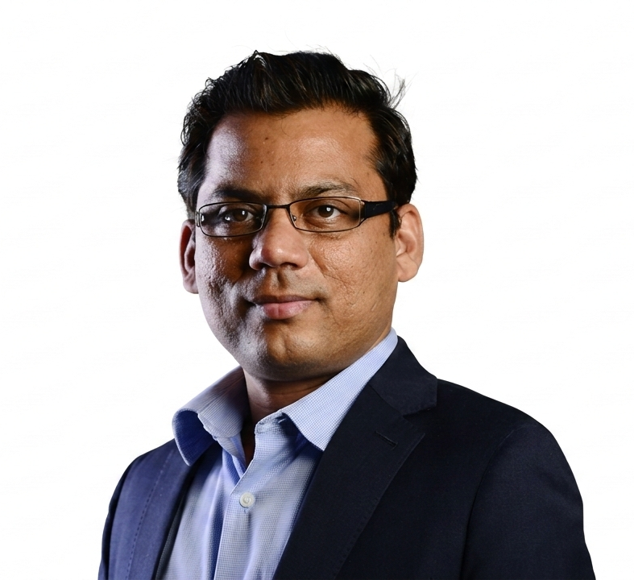
Expert Session
Shri Krishna Kumar
Founder & CEO, Simplilearn

Slide 152
State Presentations

Slide 153
State/UT Action Plans
AGENDA COVERAGE
Presentations by each State basis the State Action Plan working activity from Day 1
Presentation focus: priority actions, baseline/status, milestones, owner/support required, and next steps.
OWNER / RR: Pillar Head Training Institutions and related outreach

Slide 154
State Felicitation

Slide 155
Winner
State Name

Slide 156
Runner-up
State Name

Slide 157
Runner-up
State Name

Slide 158
THANK YOU
OWNER / RR: Pillar Head — Training Institutions & related outreach

Slide 159
Regional Workshop
From Training Institutions to Capacity Building Institutions
Vijayawada, AP
September 29 and 30, 2026
1

